Slide 1

American Creativity Academy
International Student Teaching Opportunity in Kuwait

Slide 2
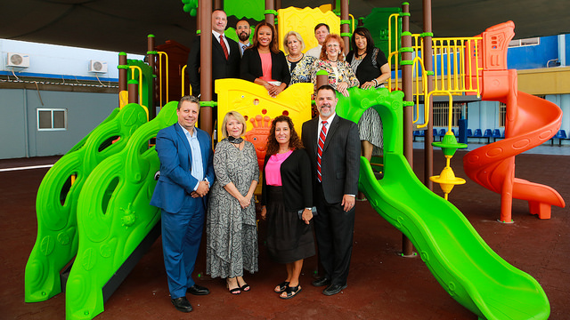
ACA Superintendent and Principals
The ACA system of schools encompasses nine different schools, each with its own administration. All schools have use the same guidelines, regulations, and curriculum, and staff from all campuses frequently collaborate.

Slide 3
ACA’s Mission Statement
The American Creativity Academy is a private school that delivers a standards-based American curriculum within an environment in which Islamic values are respected and practiced. The school is dedicated to preparing students for university success.

Slide 4
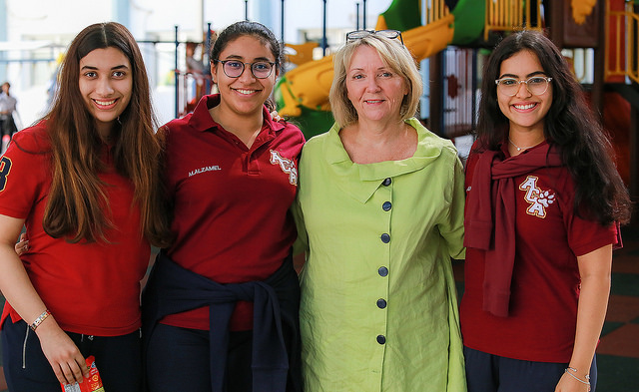
Hawally Girls’ Campus High School
Grade 12 students with their principal

Slide 5
School Profile
4500+ students, 400+ staff members
99% Kuwaiti student population, all ESL learners
Overseas teachers teach core subjects, local native-Arabic speakers teach Arabic and Islam classes
ACA does not offer music
ACA is internationally accredited by IB, CIS, and MSA
School year runs from September – mid-June

Slide 6
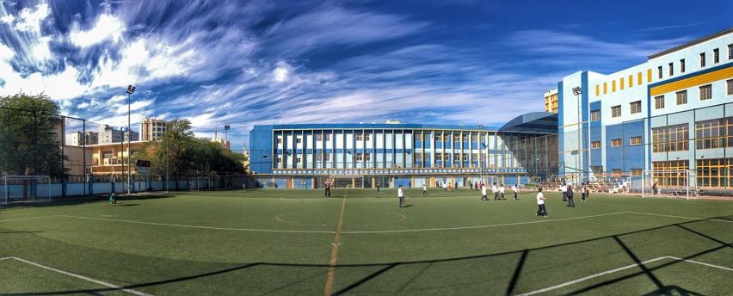
ACA Football Field
ACA sits on three separate campus locations – two in Hawally and one in neighbouring Salmiya.

Slide 7
Three Campus Locations
Hawally Girls’ Campus
Hawally Boys’ Campus
Salmiya Campus
Girls’ Elementary
  Grades 1-5 (female teachers only)
Girls’ Middle/High School
  Grades 6-12 (female teachers only)
Co-Ed KG (Kindergarten)
  PreK-KG2 (female teachers only)
Boys’ Elementary
  Grades 1-5
Boys’ Middle/High School
  Grades 6-12
Co-Ed KG (Kindergarten)
  PreK-KG2 (female teachers only)
Girls’ Elementary
  Grades 1-5 (female teachers only)
Boys’ Elementary
  Grades 1-5
Middle School
  Girls’ Grades 6-8 (female teachers only)
  Boys’ Grades 6-8

Slide 8

MAP Testing
Measure of Academic Progress (MAP) tests are administered three times a year, allowing us to gauge our students learning and understanding compared to the rest of the country and the world.

Slide 9
Core Subjects
Overseas Teachers
Local Teachers
English/Language Arts
Math
Science
Social Studies
Art
Physical Education
Arabic
Islam

Slide 10
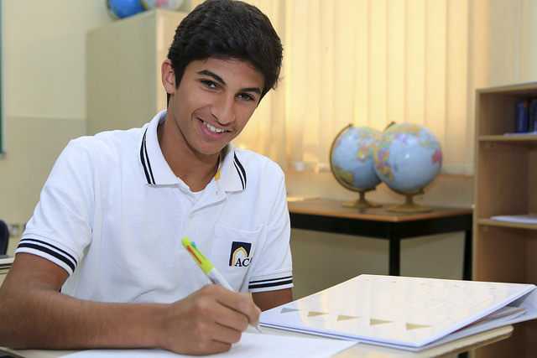
Hawally Boys’ High School Student
ACA’s curriculum is based upon Minnesota’s standards.

Slide 11
Daily Schedule
Staff hours are 6:45am-2:45pm, students are 7:15am-2:15pm
  Girls’ Campus has a staggered start 15 minutes later
School week runs Sunday to Thursday
  Weekend is Friday-Saturday
Seven 50-minute periods per day
  Contracted teacher load is 26 periods per week, averaging two preparation periods per teaching day

Slide 12
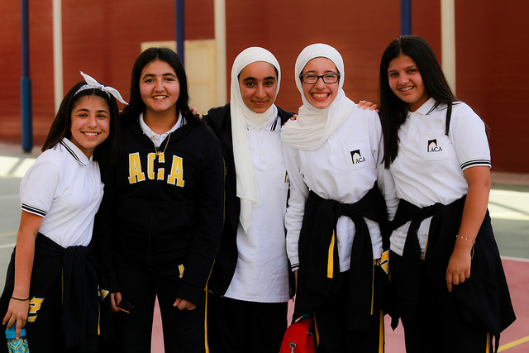
Salmiya Middle School Students
Students wear a casual and comfortable uniform to school each day, while staff have requirements for dress code.

Slide 13
Dressing for School
Students wear a school uniform
Staff must abide by the school dress code
  Men – long pants/slacks, collared shirts, tie recommended
  Women – long skirts/dresses, long pants/slacks, loose-fitting blouses that cover the hips, modest necklines, sleeves to mid-arm
  No visible tattoos or religious jewelry
  Closed-toe shoes or dress sandals
  No jeans, shorts, or capris
  PE teachers can wear track suits or sweats

Slide 14
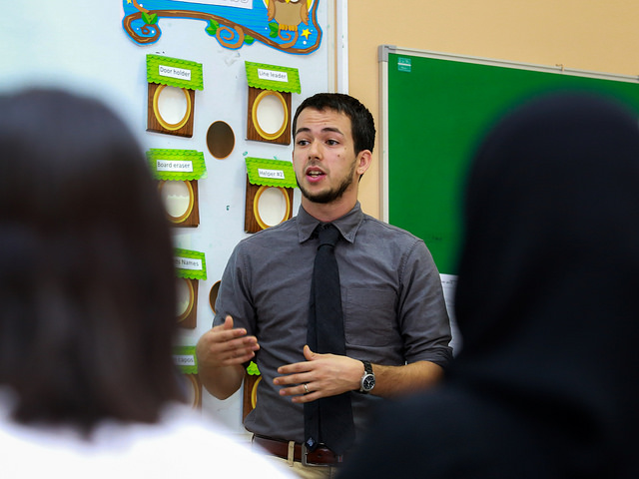
Salmiya Elementary Boys’ Teacher
Our overseas teachers are primarily from USA and Canada, but we also have teachers from the UK, Australia, New Zealand, and South Africa.

Slide 15
About Kuwait...
Kuwait is located in the Middle East on the Arabian Gulf
Hot and dry climate – temperatures range from +5°C in December/January to +50°C in July/August
The country is a Muslim country and highly westernized
  Alcohol and pork are prohibited
  Modest dress is recommended, but women are not required to cover their hair in school or out in public
  Public displays of affection are rare
Kuwait is a very safe country with citizens who are content and satisfied. There is an active embassy community and many American military bases. Common sense in everyday situations and regular “big city” vigilance is recommended.

Slide 16

Salmiya Elementary Girls’ Teacher
We have almost 500 staff, including over 175 overseas teachers, 100 local teachers, 75 teacher assistants, plus administrative staff.

Slide 17
Student Teaching at ACA
ACA provides
  Roundtrip flight with transportation to and from the airport
  Shared-accommodation in our teacher housing
  Transportation to and from school daily
  Scheduled cultural activities and events
  Certified cooperating/mentor teachers
ACA strongly recommends student teachers arrange health care coverage for the duration of their time spent in Kuwait

Slide 18
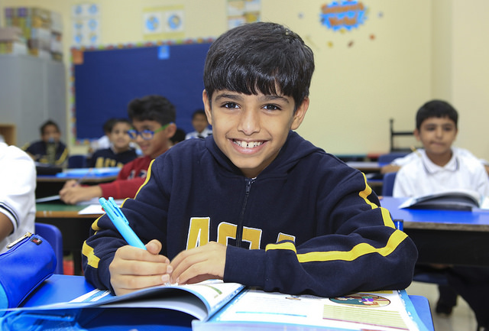
Hawally Boys’ Elementary Student
Class sizes are typically 20-25 students per class.

Slide 19
Living in Kuwait
Large expat community
Many comforts of home – groceries, restaurants, retail stores, community groups
Numerous travel opportunities during school breaks
  UAE, Egypt, Jordan, Sri Lanka, Thailand, Europe, Africa
Many sporting/fitness opportunities
  Private health clubs, cycling, rugby, hockey, soccer

Slide 20
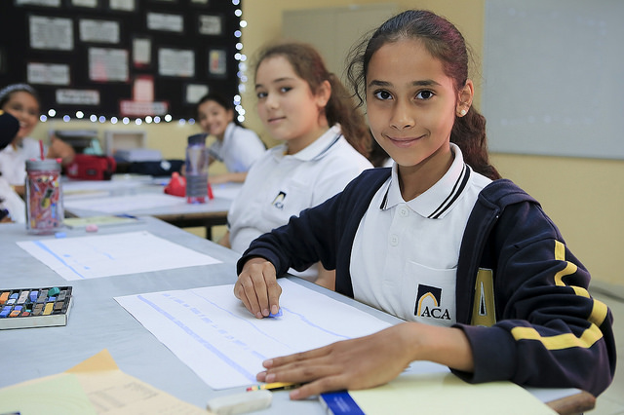
Hawally Girls’ Elementary Student
KG-Grade 2 classrooms each have a dedicated Teacher Assistant.

Slide 21
Working at ACA
Initial contract period – 2 years
Tax-free salary, no deductions
Fully-furnished one-bedroom apartment, all utilities included
Daily transportation to and from school from the housing
Medical insurance
Yearly roundtrip flight home for the summer
Settling-in allowance, excess baggage allowance, work visa allowance, PD allowance
Western-friendly school calendar (Christmas break)
Good opportunity to save money if you are not a “spender”

Slide 22

Salmiya Girls’ Elementary Student
ACA uses major textbook series to support our curriculum, including Harcourt, Houghton Mifflin, and McGraw Hill.

Slide 23
Links to learn more about ACA:
  ACA YouTube Channel
  ACA Recruitment Video
  ACA Instagram
  ACA School Website

Slide 24
For further information about ACA:
Student Teaching Opportunities
Employment Opportunities after Graduation
Contact your University’s Student Teacher/Field Experience Coordinator
Contact ACA’s Director of Teacher Recruitment
Gillian.barton@aca.edu.kw

