Slide 1
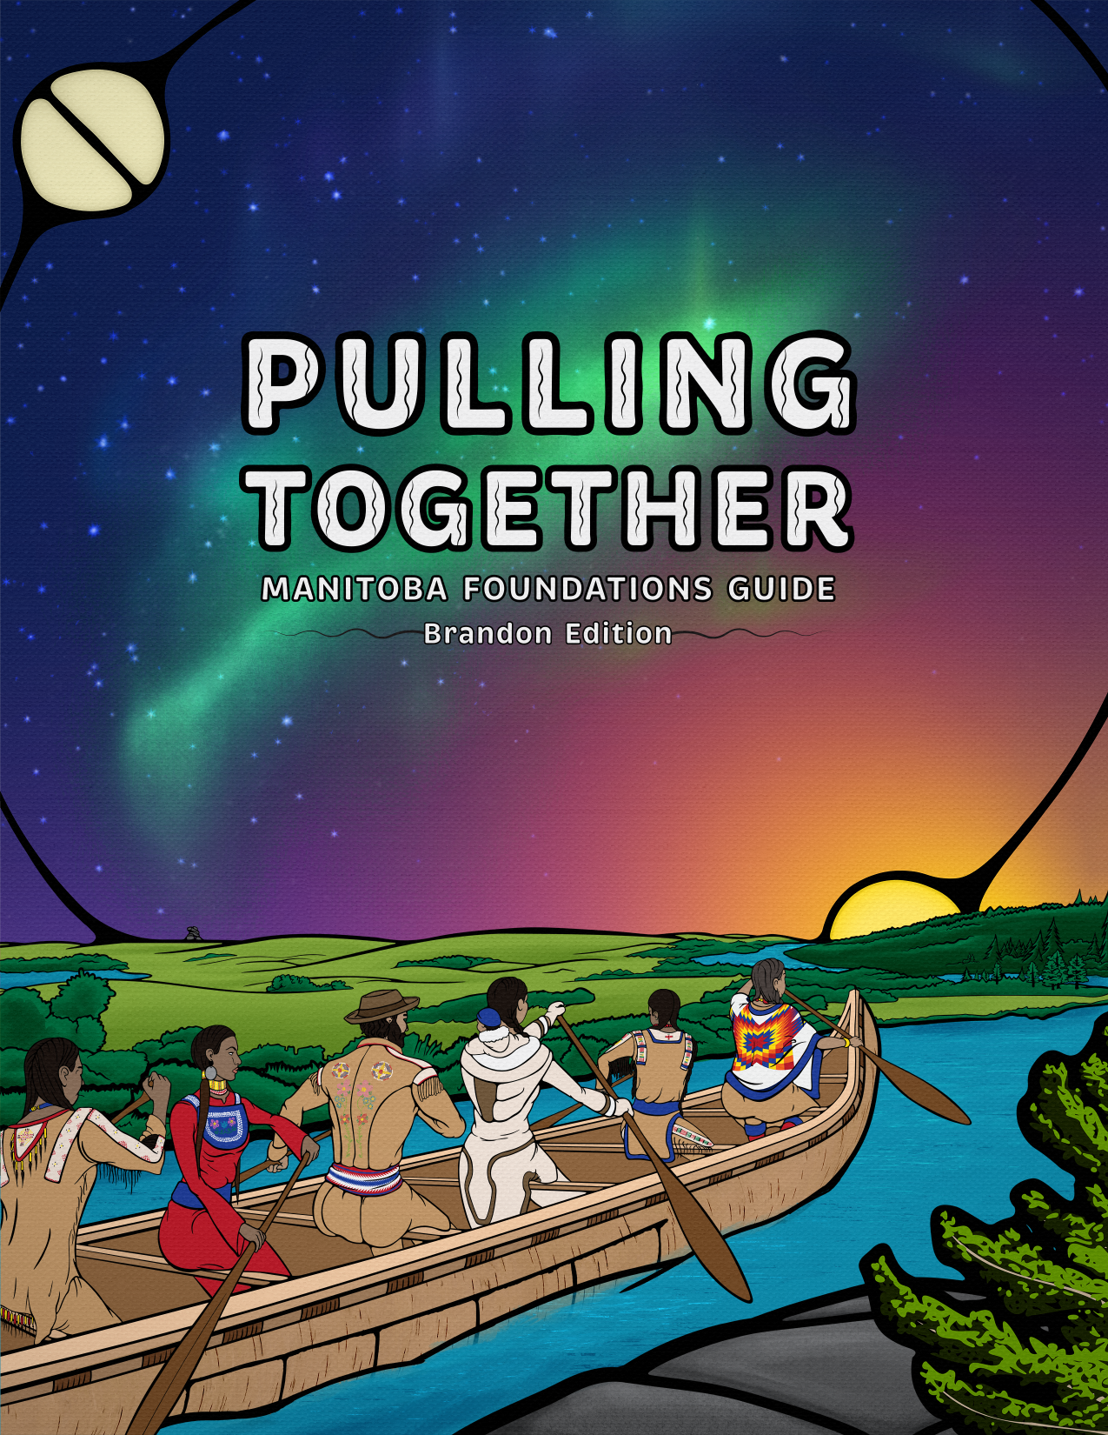
Pulling Together, Learning Together Facilitated Self-Study & Group Reflection
Notes:
Pulling Together: Manitoba Foundations Guide
Facilitator’s Guide
A resource for facilitator led self and group study
This image was created by Emery Knight
and is licensed under a CC BY-NC-ND (Attribution Non-Commercial-NoDerivs) License.
Manitoba Foundations Group. (2021). Pulling Together: Manitoba Foundations Guide (Brandon Edition).
Campus Manitoba. Retrieved from https://pressbooks.openedmb.ca/PullingTogetherManitoba

Slide 2
Pulling Together, Learning Together Facilitated Self-Study & Group Reflection
Notes:
Welcome
Welcome everyone and thank you for your interest and commitment to exploring the Pulling Together Manitoba Foundations Guide together.
https://pressbooks.openedmb.ca/pullingtogethermanitoba/
Land Acknowledgement
I wish to acknowledge that Brandon University is located on Treaty 1 and Treaty 2 lands and respects the treaties that were made here. I am grateful to be here today, with you, on the traditional homelands of the Dakota, Anishanabek, Oji-Cree and Cree peoples and the homeland of the Métis Nation.
About Pulling Together
The Pulling Together Manitoba Foundations Guide for western Manitoba is an open educational resource that was adapted and developed by local Elders, Knowledge Keepers, community members, and Indigenous organizations across Manitoba – alongside Assiniboine Community College, Brandon University, and Campus Manitoba partners.
Originally created in British Colombia as part of a larger Indigenization project, the Pulling Together: Manitoba Foundations resource provides a starting point for those who want to learn more about Indigenous Peoples in the Prairie region of Canada and those who wish to begin their journey of understanding Canada’s colonial legacy.
If gathering in-person, arrange to have people sit (on chairs or on the floor) in a circle.
In a way that is meaningful for you, begin with a welcome and land acknowledgement. (The wording provided is an example.)
NOTE: If you ask an Indigenous Knowledge Keeper, Elder, or community member to help with facilitation they will likely open with a prayer, smudge, or teaching that is culturally meaningful.
REMEMBER: This guide offers an example of how to facilitate related learning. Feel free to make it your own.

Slide 3
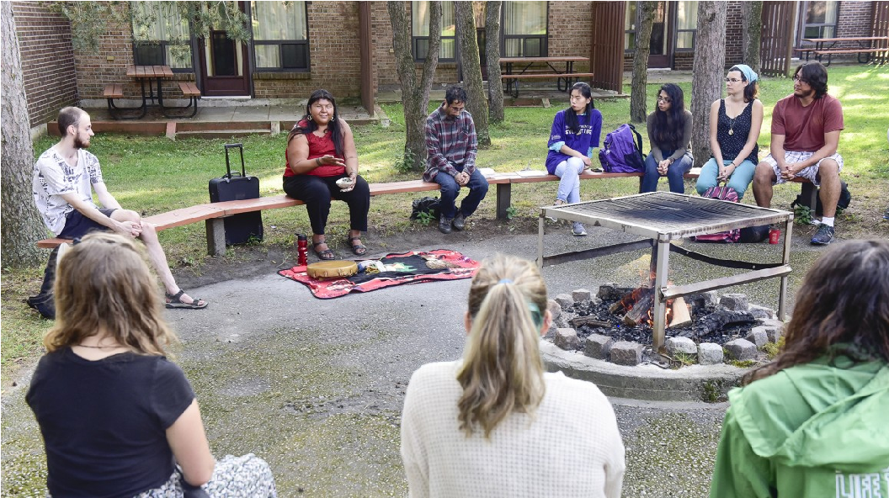
Self-Study & Group Learning Circles
Credit: Elder Wendy Phillips - University of Toronto Scarborough, Photo by Ken Jones
Photo Credit: University of Toronto Scarborough
Notes:
Program Format
Over the coming weeks/months, we will spend some time, independently, reading through the sections of the guide and engaging with the different links, videos and activities that support deeper learning. The guide invites us to go beyond its pages and to go out into the world - our own contexts and communities – and to “seek out experiences that will contribute to our understanding”. (Overview)
Then, we will come back together to reflect on what we’ve learned and how this can foster change in how we move forward in the world. These gatherings will take place in the form of a learning circle.
The circle is an important structure in Indigenous cultures. “In a circle, everyone is equal, as well as interconnected. This ‘coming together in unity’ builds a strong sense of ‘community’.”
(About Sharing Circles, Ravenspeaks)
We will learn more about how to engage in the learning circle later on.
Provide overview of program format.

Slide 4
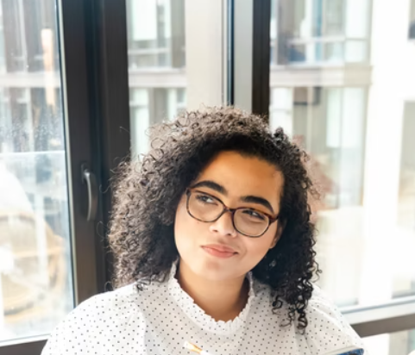
Reflection Activity:
Take a few minutes to consider the broader purpose of the guide in relation to your own context and spaces.
Share with the group, your purpose for participating in this group exploration of the guide. What do you hope to offer and gain from participating?
Notes:
Purpose
As shared in the guide’s overview, the purpose of the guide is “to support the systemic change occurring across post-secondary institutions and beyond through Indigenization, decolonization, and reconciliation”. Exploring this guide together provides an opportunity for us to think about our roles in working toward decolonization and supporting Indigenous awareness and perspectives in our spaces (e.g. our departments, the classroom, social spaces and communities).
Reflection Activity:
Considering the broader purpose of the guide in relation to your own context and spaces, what is your purpose for participating in this group exploration of the guide? What do you hope to offer and receive from participating?
(Reflection & Discussion occurs)
FOLLOWING THE ACTIVITY:
Introduce the HOW for achieving purpose
We’ve noted the authors’ shared purpose for creating the guide and explored our own purpose for wanting to explore it together and to learn more. Now let’s give thought to HOW we will do so.
For the Reflection Activity, here are a few different options for facilitation.
Virtual Gathering: Consider having participants share in chat or on a digital post-it board (e.g. Google Jamboard). You might use breakout rooms for small group discussion, bringing it back to the larger group.
In-Person Gathering: Using post-its or flipcharts, invite participants to write down and post their purpose statements around the room. Participants will move around the room to see what others have shared.
As the facilitator, record and compile these; making them available to the group at each gathering for reference.

Slide 5
Artistic Inspiration for Pulling Together
Pulling Together Manitoba Foundations (2021)
Front Cover Art by Anishanaabe Artist Emery Knight
Pulling Together Manitoba Foundations (2021.
Back Cover Art by Anishanaabe Artist Emery Knight
Notes:
The Artist who created the cover art invites us to do just that. The Pulling Together: Manitoba Foundations Guide (Brandon Edition) was created by Emery Knight and influenced by the works of Lou-ann Nell, a Kwakwaka’wakw artist.
“Emery Knight is an Anishanaabe Artist who grew up in the Parkland and Brandon areas who respected Neel’s voice and story as a guide to reflect his vision of Indigenous Peoples in Manitoba.
The end of the birch bark canoe bleeds off the page to represent the space that there is for everyone on this journey. The river flows from the foreground to the background, from left to right, and ebbs back and forth to express the journey’s path into the unknown, and acknowledges the organic nature of it. The only way forward is together, guided by our grandmother and grandfather’s teachings of the land.” (Artist Statement)
With that in mind, let’s open ourselves to the teachings and learning that this resource and opportunity offers us. The guide’s Preface acknowledges that “the relationship between non-Indigenous and Indigenous people has not been an easy one, but it is vital that this relationship continue to improve. The strength of a good relationship is that everyone understands and knows the truth about past and contemporary realities.”
The guide shares many hard truths. To help us learn together in a welcoming and respectful way, let’s take a bit of time to outline some guidelines for coming together.
Reference the cover art and share the artist’s statement.

Slide 6
Guidelines for Engagement - The 4 Rs
RESPECT
For the land we gather on and the lessons it offers.
For the teachings and traditions shared by Indigenous Elders and Knowledge Keepers.
For the stories shared by all in attendance – both Indigenous and non-Indigenous participants.
Notes:
A welcoming space to share and learn!
In a few minutes, you will be invited to describe the kinds of actions and interactions that you need to be at your best and that contribute to a supportive space for learning, growth, and change.
To get us started, I would like to share the 4Rs as a foundation for this type of gathering and interaction. These have been inspired by the works of Indigenous scholars Verna Kirkness and Ray Barnhardt.
The first R is Respect.
Respect – For the land we gather on and lessons it offers. For the teachings and traditions shared by Indigenous Knowledge Keepers and Elders. For the stories shared by all in attendance – both Indigenous and non-Indigenous participants.
Review the 4Rs.

Slide 7
Guidelines for Engagement - The 4 Rs
RESPECT
RELEVANCE
We reflect on the stories and personal experiences that are shared and consider how they relate to our own. In doing so, we build on and expand understanding of ourselves in relation to those around us and the world we live in.
Notes:
The second R is Relevance.
Relevance – We reflect on the stories and personal experiences that are shared and consider how they relate to our own. In doing so, we build on and expand understanding of ourselves in relation to those around us and the world we live in.
Review the 4Rs.

Slide 8
Guidelines for Engagement - The 4 Rs
RESPECT
RELEVANCE
RESPONSIBILITY
We create and contribute to a space that honours Indigenous knowledges and cultures and brings people with diverse backgrounds and experiences together.
Notes:
The third R is Responsibility.
Responsibility – We create and contribute to a space that honours Indigenous knowledges and cultures, celebrates the voices of young people, and brings people with diverse backgrounds and experiences together.
Review the 4Rs.

Slide 9
Guidelines for Engagement - The 4 Rs
RESPECT
We listen to and learn from the knowledge, stories and experiences of others, while also offering our own (give and take). In doing so, we cultivate mutually respectful relationships from which we all benefit.
RECIPROCITY
RELEVANCE
RESPONSIBILITY
Notes:
And the fourth R is Reciprocity.
Reciprocity – We listen to and learn from the knowledge, stories and experiences of others, while also offering our own (give and take). In doing so, we cultivate mutually respectful relationships from which we all benefit.
Once again, inspired by the works of Indigenous scholars, I ask you to remember these when we gather for reflection after each section.
Additionally, I would like you to, now, give some thought to anything else that you might want to add to these as guidelines for engagement.
(More details on next slide)
Review the 4Rs & invite the group to build on this.
Ask: What do we need from each other so that we are contributing to a supportive space for learning, growth and change?
Invite participants to share (e.g. raise there hand, put into chat)
Record these and refer back to these at the start of each gathering.

Slide 10
Guidelines for Engagement - The 4 Rs
RESPECT
RELEVANCE
RECIPROCITY
RESPONSIBILITY
Individual Activity:
In addition to the 4Rs, is there anything else you might need from each other so that we are contributing to a supportive space for learning, growth, and change?
Notes:
Reflection Activity:
What might you need from one another to help cultivate a supportive space for learning, growth and change?
(Reflection & Discussion occurs)
----------------------------------
These have been noted and I will share these with our group for reference at each gathering.
Review the 4Rs & invite the group to build on this.
Ask: What do we need from each other so that we are contributing to a supportive space for learning, growth and change?
Invite participants to share (e.g. raise there hand, put into chat)
Record these and refer back to these at the start of each gathering.

Slide 11
Details for Section I: Intro to Indigenous Peoples
Self-Study (approx. 1.5 hours) | Reflection Questions for Next Gathering Discussion
Read Preface, watch video & complete activity Read Glossary of Terms Read Section I – Intro to Indigenous Peoples (pgs 1 – 9) Including links & watch videos Complete Intro: Locate Yourself Activity (pg 1) Complete Knowledge Check (appears at end of section) | Share one particular aspect within the first section (e.g. topic, video, activity) that really resonated with you and why? What is one new thing you learned (or unlearned) and how might you carry that learning forward in your own context (e.g. professionally, personally)
Notes:
Readings & Reflection for Next Gathering
Thank you all again for your interest in the Pulling Together: Manitoba Foundations Guide. I look forward to learning with you.
Prior to our next gathering, you are asked to complete the following self-study readings and activities.
Post the assignment details in a shared space for reference (e.g. OneDrive, Moodle, Teams).
Provide details for your next gathering (e.g. date, time, location).
NOTE: How you choose to schedule the time between gatherings will depend on the needs and preferences of group members.

Slide 12
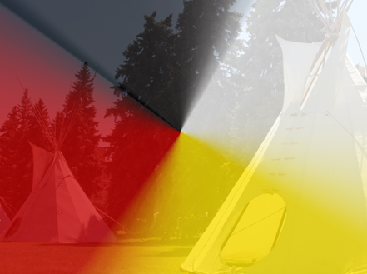
Welcome back!
Section I: Learning Circle
Reflecting & Discussing Together
Notes:
Welcome everyone to the Learning Circle for Section I.
<Consider incorporating a warm up or grounding activity.>
Guidelines for Engagement
As we move into today’s gathering, let’s take a moment to think back to the 4Rs and additional guidelines for participating in a good way, as identified by the group at the initial gathering.
(Refer participants to these.)
In Section 1, we were introduced to some of the basic history and culture of Indigenous Peoples on Turtle Island and challenged some common myths or misconceptions. Today we will have the opportunity to reflect on what you learned and to share this with the group.
Acknowledging that this guide explores many hard truths, you may feel the need to stay back to debrief following the circle. I will be here. If you feel you need additional support, I’ve provided you with contact information of local resources – on and off campus.
Learning Circle for Sharing
As mentioned at the initial gathering, we will be sharing in a format that reflects the importance of the circle – a structure that in Indigenous cultures positions everyone as equal and interconnected.
If In-person, have everyone sit (on chairs or the floor) or stand in a circle, as they come in.
Share the link to the Guidelines for Engagement in chat (if virtual) or on poster in the room (if in-person).
Acknowledging the difficulty that some may have with exploring the hard truths within the guide, provide participants with a list of resources for additional support. These can be found at the end of the guide.
Offer personal support to participants if needed (e.g. EAP, Counselling, Elders).
Bring a box of Kleenex when gathered in-person.

Slide 13
Section I: Learning Circle
Share one particular aspect within the first section (e.g. topic, video, activity) that really resonated with you and why?
What is one new thing you learned (or unlearned) and how might you carry that learning forward in your own context (e.g. professionally, personally)?
Notes:
For in-person gathering:
When you came in, I invited you to find a space, positioning yourselves in a circle.
In just a moment, I will begin by introducing myself by sharing my name and reflecting on one of the discussion questions. I will then invite the person seated next to me (often to my left) to do the same (or ask for a volunteer). The person to their left will do the same – and so on – until everyone has had the opportunity to share around the circle. While everyone is encouraged to share, it is ok to pass, inviting the next person to carry on. The only time we are speaking is when it is our turn, otherwise we are listening.
For virtual gathering:
Given we are gathered virtually, we are not physically positioned in a circle, however, the way we will share is done so in the same spirit.
In just a moment, I will begin by introducing myself by sharing my name and reflecting on one of the discussion questions. I will call on an individual (or ask for a volunteer) to do the same. They will call on another person after they have shared – and so on, and so on - until everyone has had the opportunity. While everyone is encouraged to share, it is ok to pass, inviting the next person to carry on.
(Read out the reflection question(s) from the slide.)
Facilitator Instructions
Provide details for how the learning circle will take place, based on whether you are gathering in-person or virtually.
Depending on the amount of time allotted for the circle and the number of participants, you may want to ask participants to be mindful of these details in relation to how long they speak. Let individuals know that you will stay around after the circle if they feel they need to share or debrief further.
By having you initiate the circle, you are able to model what you are asking of the participants.
NOTE: If in-person, you may choose to have an item to pass around as people take their turn to share (e.g. talking stick, stone, or other special item)
TIP: When virtual, keep note of those who have shared (either in chat or on a piece of paper) to help keep track of those who have shared.

Slide 14
Details for Section II: Colonization
Self-Study (approx. 3 hours) | Reflection Questions for Next Gathering Discussion
Read Section II – Colonization (pgs 10 – 22) Including links and watch videos Complete Intro Activity: Locate Yourself Complete Knowledge Check | a. What are some of the ways we see our colonial history reflected in our own institutional systems, in day-to-day interactions with colleagues, students and the community? b. What are the broader impacts of this, particularly for Indigenous members of the campus community? 2. Share one particular aspect within the first section (e.g. topic, video, activity) that really resonated with you and why? 3. What is one new thing you learned (or unlearned) and how might you carry that learning forward in your own context (e.g. professionally, personally)?
Notes:
Readings & Reflection for Next Gathering
Thank you all for your sharing. I am sure that your reflections have prompted additional learning for others and I encourage you to connect outside of these gatherings to keep that conversation going.
If any of you need some support or feel you need to talk things through a bit further, I will stay here for awhile longer. Again, these hard truths can be difficult and if you feel you need additional support – I’ve provided you with contact information of local resources, on and off campus.
In preparation for our next gathering, you are asked to complete the following self-study readings and activities.
Post the assignment details in a shared space for reference (e.g. OneDrive, Moodle, Teams).
Provide details for your next gathering (e.g. date, time, location).
NOTE: How you choose to schedule the time between gatherings will depend on the needs and preferences of group members.

Slide 15
Welcome back!
Section II: Learning Circle
Reflecting & Discussing Together
Notes:
Welcome everyone to the Learning Circle for Section II.
<Consider incorporating a warm up or grounding activity.>
Guidelines for Engagement
As we move into today’s gathering, let’s take a moment to think back to the 4Rs and additional guidelines for participating in a good way, as identified by the group at the initial gathering.
(Refer participants to these.)
Once again, this section explores many hard truths. If you feel you need to stay back to debrief following the circle, I will be here. If you feel you need additional support, I’ve provided you with contact information of local resources – on and off campus.
Learning Circle for Sharing
As we did the last time we gathered, we will be sharing in a format that reflects the importance of the circle.
If In-person, have everyone sit (on chairs or the floor) or stand in a circle, as they come in.
Share the link to the Guidelines for Engagement in chat (if virtual) or on poster in the room (if in-person).
Acknowledging the difficulty that some may have with exploring the hard truths within the guide, provide participants with a list of resources for additional support. These can be found at the end of the guide.
Offer personal support to participants if needed (e.g. EAP, Counselling, Elders).
Bring a box of Kleenex when gathered in-person.

Slide 16
Section II: Learning Circle
a) What are some of the ways we see our colonial history reflected in our own institutional systems, as well as day-to-day interactions with colleagues, students and the community?
b) What are the broader impacts of this, particularly for Indigenous members of the campus community?
2. Share one particular aspect within the first section (e.g. topic, video, activity) that really resonated with you and why?
3. What is one new thing you learned (or unlearned) and how might you carry that learning forward in your own context (e.g. professionally, personally)?
Notes:
Overview Statement of Section II
In Section II, we learned about colonization and how it has affected (and continues to affect) Indigenous peoples. We also began to look at the relationship between Indigenous and non-Indigenous peoples.
Learning Circle for Sharing
As we did the last time we gathered, we will be sharing in a format that reflects the importance of the circle.
I will begin by introducing myself by sharing my name and reflecting on one of the discussion questions. I will then invite one of you to do the same and we will continue until everyone has had the opportunity. Again, everyone is highly encouraged to share, however, it is ok to pass if you need to. Simply invite the next person to carry on. The only time we are speaking is when it is our turn, otherwise we are listening.
(Read out the reflection question(s) from the slide.)
Facilitator Instructions
Provide details for how the learning circle will take place, based on whether you are gathering in-person or virtually.
Depending on the amount of time allotted for the circle and the number of participants, you may want to ask participants to be mindful of these details in relation to how long they speak. Let individuals know that you will stay around after the circle if they feel they need to share or debrief further.
By having you initiate the circle, you are able to model what you are asking of the participants.
NOTE: If in-person, you may choose to have an item to pass around as people take their turn to share (e.g. talking stick, stone, or other special item)
TIP: When virtual, keep note of those who have shared (either in chat or on a piece of paper) to help keep track of those who have shared.

Slide 17
Details for Section III: Decolonization
Self-Study (approx. 1 hours) | Reflection Question for Next Gathering Discussion
Read Section III – Decolonization (pgs 23 – 28) Including links and watch videos Complete Intro Activity: Locate Yourself Complete Knowledge Check | “As Canadians, we can all take part in building a genuine decolonization movement. This movement would respect the land on which we are all living and the people whom it inherently belongs.” (Pulling Together, 2021, pg 26) 1. What would decolonization look like in your context (professional and/or personal)?
Notes:
Readings & Reflection for Next Gathering
Thank you all for your sharing. I am sure that your reflections have prompted additional learning for others and I encourage you to connect outside of these gatherings to keep that conversation going.
If any of you need some support or feel you need to talk things through a bit further, I will stay here for awhile longer. Again, these hard truths can be difficult and if you feel you need additional support – I’ve provided you with contact information of local resources, on and off campus.
In preparation for our next gathering, you are asked to complete the following self-study readings and activities.
Post the assignment details in a shared space for reference (e.g. OneDrive, Moodle, Teams).
Provide details for your next gathering (e.g. date, time, location).

Slide 18
Welcome back!
Section III: Learning Circle
Reflecting & Discussing Together
Notes:
Welcome everyone to the Learning Circle for Section III.
<Consider incorporating a warm up or grounding activity.>
Guidelines for Engagement
As we move into today’s gathering, let’s take a moment to think back to the 4Rs and additional guidelines for participating in a good way, as identified by the group at the initial gathering.
(Refer participants to these.)
Once again, this section explores many hard truths. If you feel you need to stay back to debrief following the circle, I will be here. If you feel you need additional support, I’ve provided you with contact information of local resources – on and off campus.
Learning Circle for Sharing
As we did the last time we gathered, we will be sharing in a format that reflects the importance of the circle.
If In-person, have everyone sit (on chairs or the floor) or stand in a circle, as they come in.
Share the link to the Guidelines for Engagement in chat (if virtual) or on poster in the room (if in-person).
Acknowledging the difficulty that some may have with exploring the hard truths within the guide, provide participants with a list of resources for additional support. These can be found at the end of the guide.
Offer personal support to participants if needed (e.g. EAP, Counselling, Elders).
Bring a box of Kleenex when gathered in-person.

Slide 19
Section III: Learning Circle
“As Canadians, we can all take part in building a genuine decolonization movement. This movement would respect the land on which we are all living and the people whom it inherently belongs.” (Pulling Together, 2021, pg 26)
1. What would decolonization look like in your context (professional and/or personal)?
Notes:
Overview Statement of Section III
In Section III, we continued to explore the legacy of colonization and ways society continues to discriminate against Indigenous peoples. By way of decolonization, we also learned about the ways Indigenous peoples are regaining their rightful place in Canada and thriving – acknowledging that we all have a role and responsibility in the process and movement for decolonization. An important part of decolonization is reconciliation – which includes Indigenous peoples sharing their stories and being heard. What we are doing here, is an act of reconciliation.
Learning Circle for Sharing
I will begin our circle by introducing myself by sharing my name and reflecting on one of the discussion questions. I will then invite one of you to do the same and we will continue until everyone has had the opportunity. Again, everyone is highly encouraged to share, however, it is ok to pass if you need to. Simply invite the next person to carry on. The only time we are speaking is when it is our turn, otherwise we are listening.
(Read out the reflection question(s) from the slide.)
By having you initiate the circle, you are able to model what you are asking of the participants.
NOTE: If in-person, you may choose to have an item to pass around as people take their turn to share (e.g. talking stick, stone, or other special item)
TIP: When virtual, keep note of those who have shared (either in chat or on a piece of paper) to help keep track of those who have shared.

Slide 20
Thank you for making the Pulling Together Manitoba Foundations Guide part of your learning journey.
Notes:
Wrap Up
Thank you for making the Pulling Together Manitoba Foundations Guide part of your learning journey. In the coming weeks, we ask you to put this learning into action. We just gave thought to what decolonization would look like in your personal context and to consider next steps for action.
Two months from now, we will meet again, offering you the opportunity to come back together to share stories about those next steps – the successes and challenges – and what you continued to learn from these experiences.
NOTE: If the facilitator is an Indigenous Knowledge Keeper, Elder, or community member, they will likely close with a prayer, song, or teaching that is culturally meaningful.

Slide 21
Additional Facilitator Resources
About Sharing Circles, Raven Speaks
List of Local Support Resources, BU Indigenous Peoples Centre
<insert link>
Notes:
Share these with the group as references and resources.

