Slide 1
Winnipeg Campus Expansion 2022

Slide 2
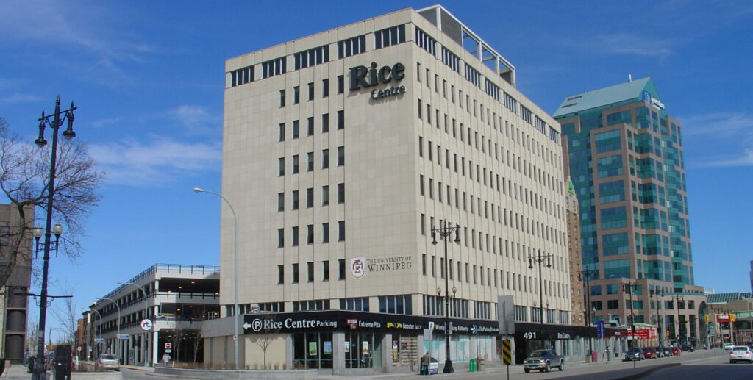
Winnipeg Campus Expansion Project
The Faculty of Health Studies, Department of Psychiatric Nursing Winnipeg Campus expansion began in February 2022 with consultant and design work being awarded to MCM Architects Inc.
ParkWest Projects Ltd. began demolition in May 2022 and new construction started mid-June 2022.
Faculty, Staff, and Students were to be using the new space as of September 2022.
Winnipeg Campus – Rice Centre 602-491 Portage Avenue
Winnipeg, MB R3B 2E4
Photo: Capital Commercial Real Estate

Slide 3
Expansion & Renovation
6th Floor Expansion: With an increase of student seats, additional space was needed to physically expand; the remainder of the unoccupied Rice Centre, 6th floor space was chosen for construction. A 65-person classroom, staff meeting lounge, administration and faculty offices, as well as an additional 10-bed nursing skills lab were designed to be constructed in this new, expanded space.
Basement Renovation: Our current space in the Rice Centre basement B104 was altered to accommodate the 6th Floor changes. The basement student lounge and kitchenette was demolished to make a larger 60-person classroom, and expanded study lounge. A larger student lounge, and new Individual and Family counselling labs and their corresponding observation suites were also built across the hall in B105.

Slide 4
PART 1
DEMOLITION

Slide 5
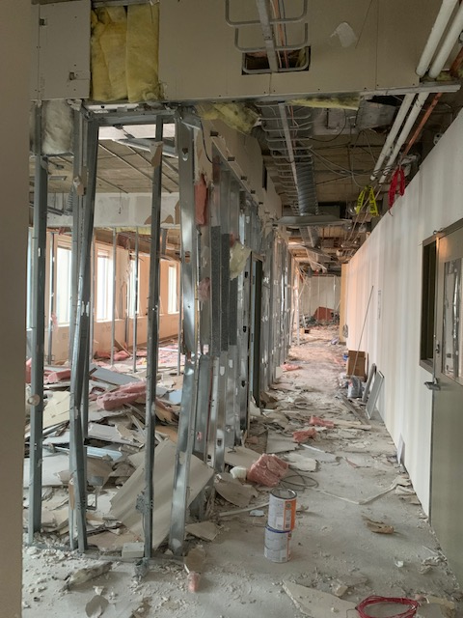
6th Floor – Demolition
Soon to be: Administration Entrance

Slide 6
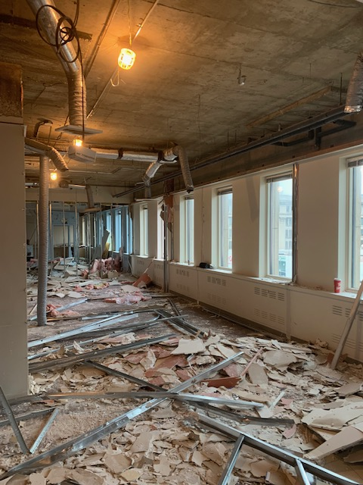
6th Floor – Demolition
Soon to be: Faculty Lounge & Meeting Room (South)

Slide 7
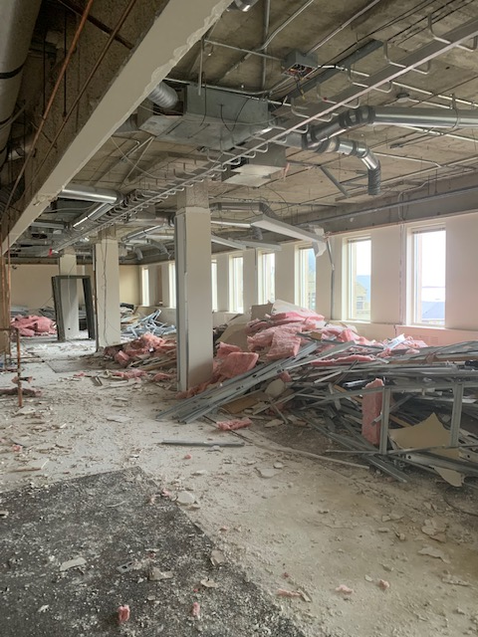
6th Floor – Demolition
Soon to be: New Nursing Skills Lab 610 (North)

Slide 8
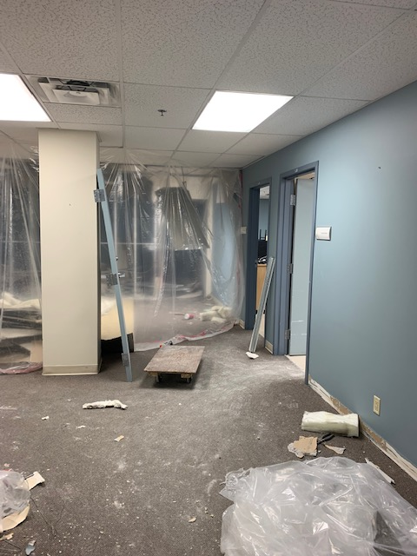
B104 Basement – Demolition
Soon to be: Classroom L37, Group Counselling Lab, Study Lounge

Slide 9
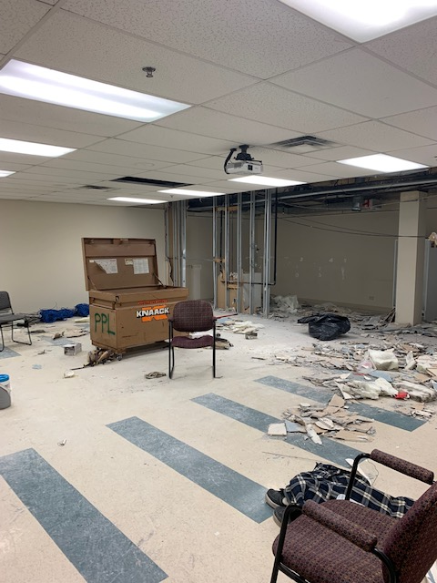
Basement B104 – Demolition
Soon to be: Expanded Classroom L37

Slide 10
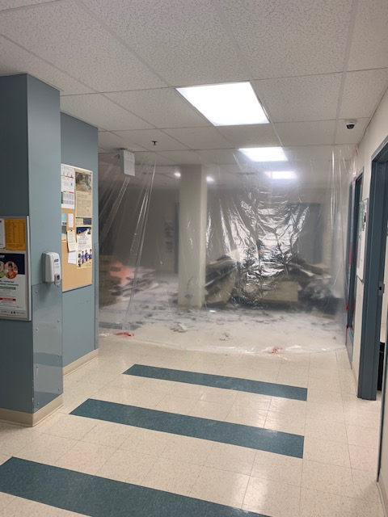
Basement B105 – Demolition
Soon to be: Counselling Labs, Entrance to Offices

Slide 11
PART 2
Growing: CONSTRUCTION & RENOVATION

Slide 12
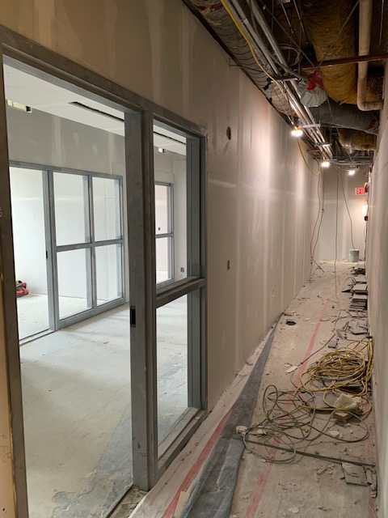
6th Floor – Construction
Administration Entrance

Slide 13
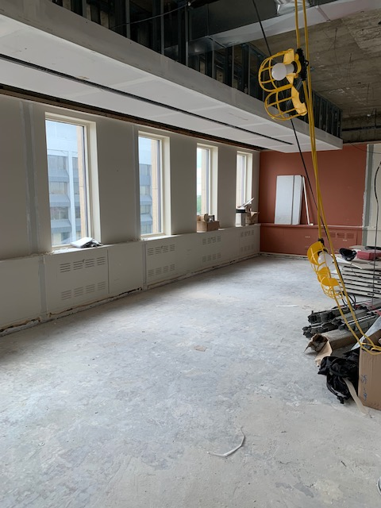
6th Floor – Construction
Faculty Lounge & Meeting Room (South)

Slide 14
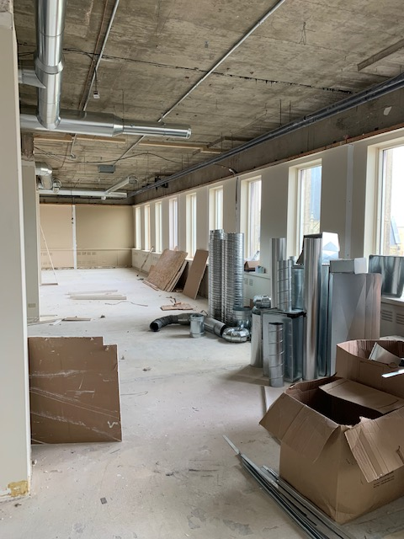
6th Floor – Construction
New Nursing Skills Lab 610 (North)

Slide 15
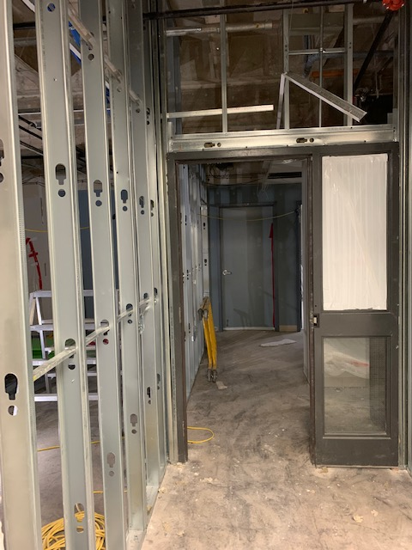
B104 Basement – Construction
Main Entrance to Classroom L37, Group Counselling Lab, Study Lounge

Slide 16
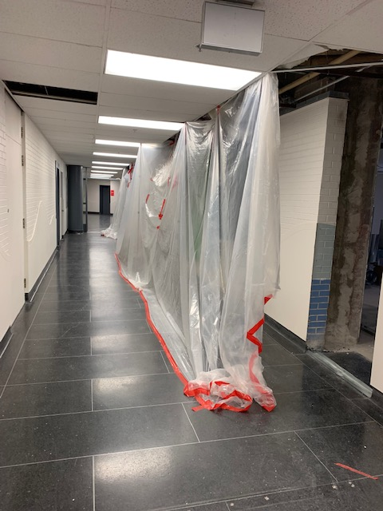
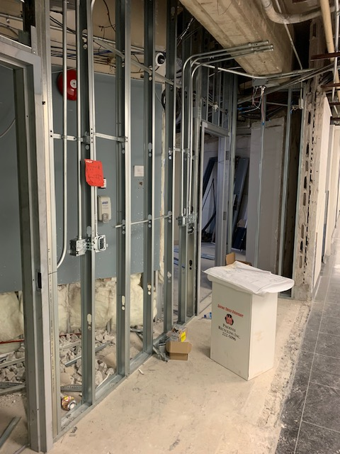
Basement B104 – Construction
Creating a new Hallway entrance for Classroom L37

Slide 17
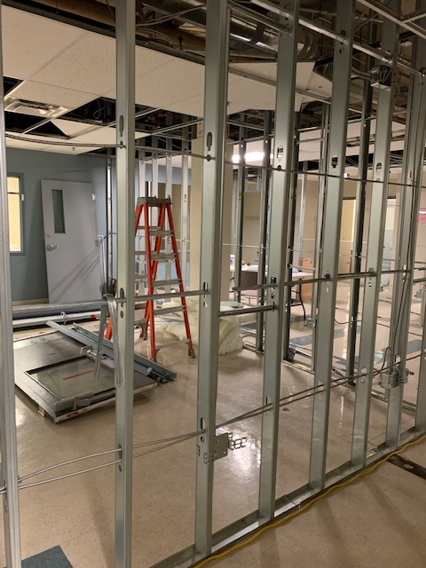
Basement B105 – Construction
Counselling Labs/Suites/Observation Room

Slide 18
When it all fell apart…
July 2022: Around the Canada Day long weekend, a part in the flushing mechanism of a toilet in the Men’s Washroom in B105 failed, causing pressurized water to spray and destroy the drop ceiling in the Men’s Washroom. The resulting pooling water flooded the majority of our B105 space under renovation.
Though some of the new walls had already been constructed, thankfully no drywall had yet been installed.
The existing Faculty offices not scheduled for renovation now had to be packed-up, cleaned, and renovated due to water leaking down into their carpet and soaking up into their walls.
The project was now officially behind schedule…

Slide 19
PART 3
Working together: our new space

Slide 20
Thanks to the creativity, planning, and dedication of our crew of industry professionals, the renovation completion of B105 was only pushed back to Thanksgiving of October 2022.
A weekly plan organizing labourers, painters, and cleaners was made to finish the areas needed for a back-to-school start date of September 2022.
On September 7, 2022, our students were officially learning in their new campus spaces.
Faculty with new offices built on the 6th floor were moved in to their offices by the end of September, and those with offices in the flood zone moved in after Thanksgiving.

Slide 21
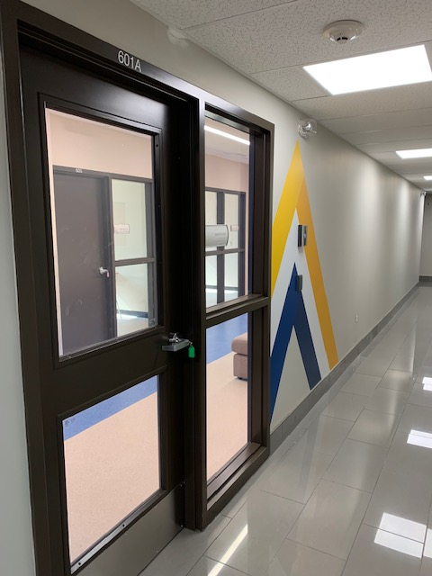
6th Floor – Winnipeg Site
Administration Entrance

Slide 22
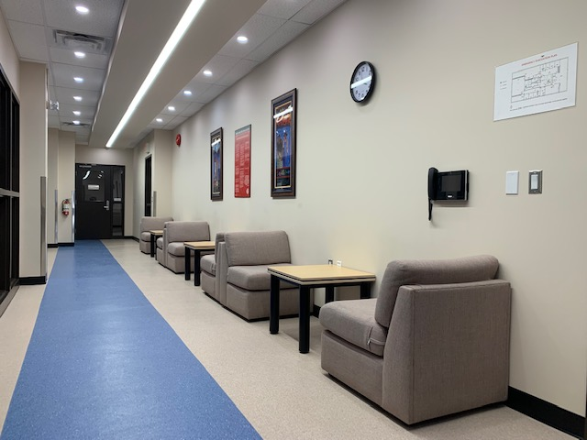
6th Floor – Winnipeg Site
Administration Hallway

Slide 23
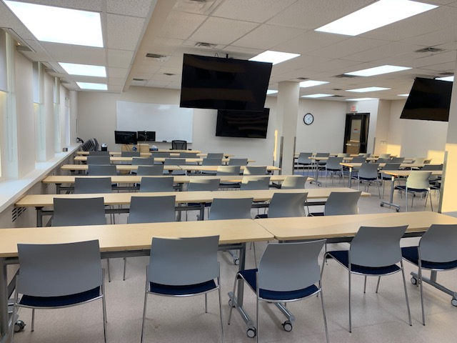
6th Floor – Winnipeg Site
Classroom 609 (South Side Expansion)

Slide 24
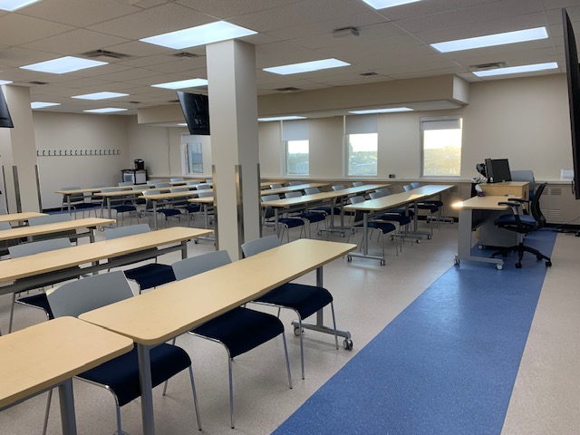
6th Floor – Winnipeg Site
Classroom 609

Slide 25
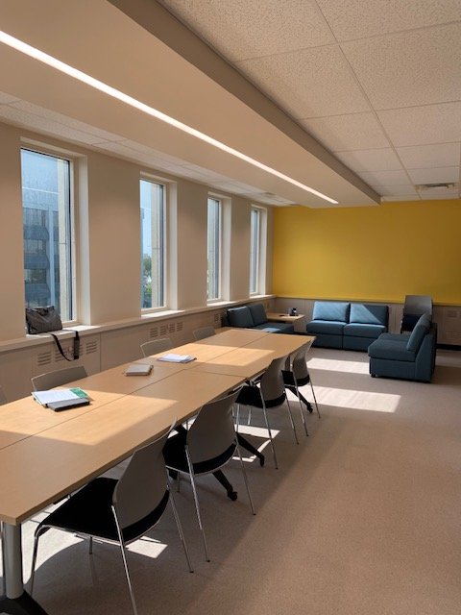
6th Floor – Winnipeg Site
Faculty Lounge & Meeting Room (South Side Expansion)

Slide 26
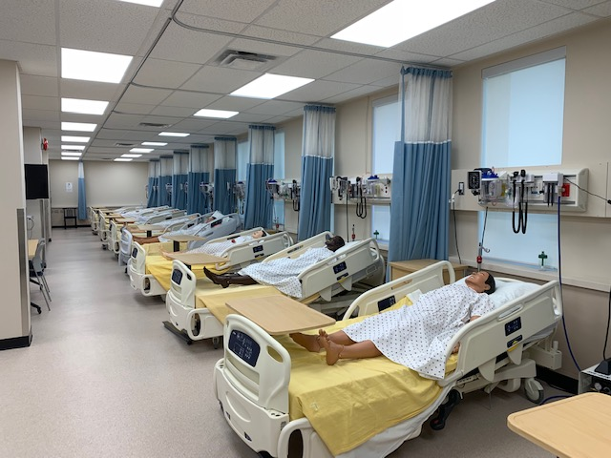
6th Floor – Winnipeg Site
New Nursing Skills Lab 610 (North Side Expansion)

Slide 27
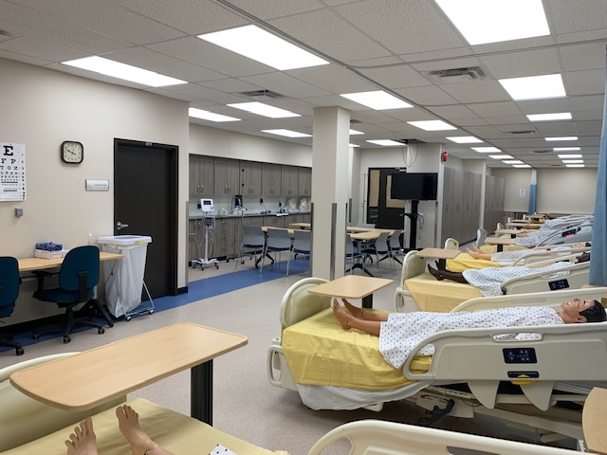
6th Floor – Winnipeg Site
New Nursing Skills Lab 610 (North Side Expansion)

Slide 28
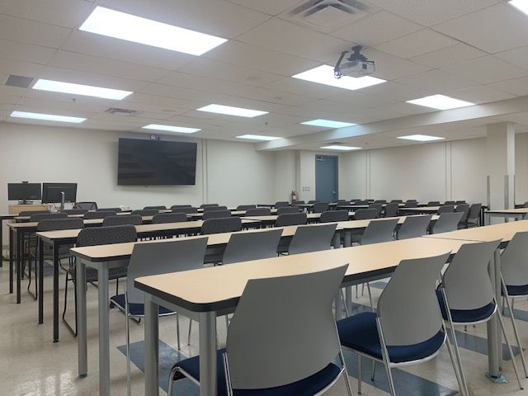
B104 Basement – Winnipeg Site
Classroom L37

Slide 29
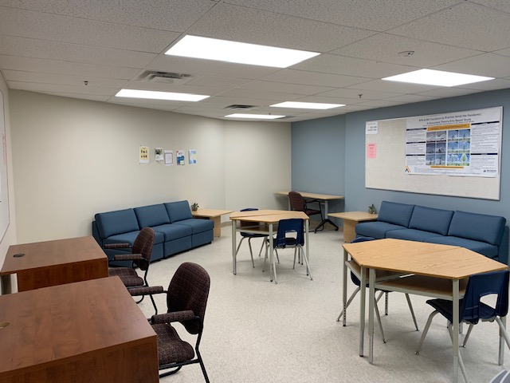
B104 Basement – Winnipeg Site
Student Study Lounge L41

Slide 30
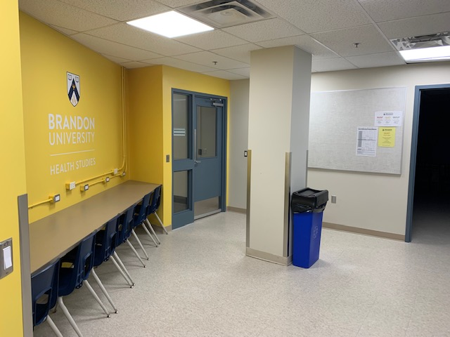
B104 Basement – Winnipeg Site
Laptop Bar L39

Slide 31
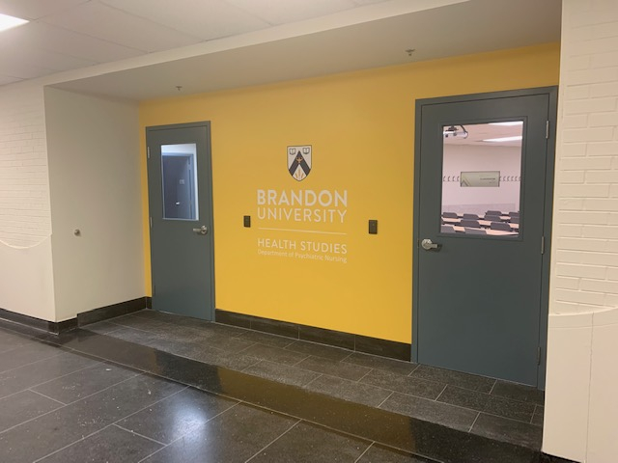
Basement B104 – Winnipeg Site
Hallway entrance for Classroom L37

Slide 32
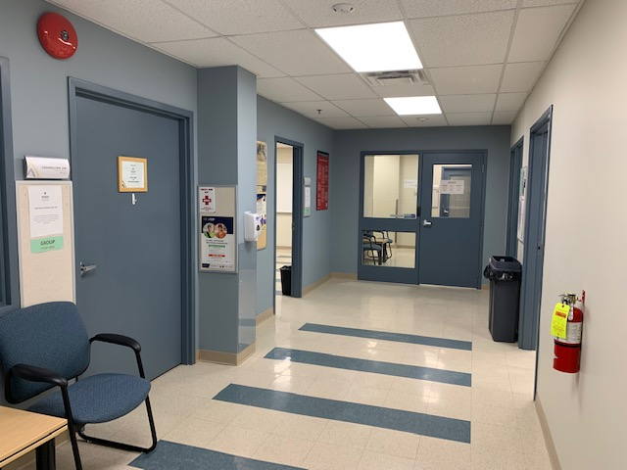
Basement B105 – Winnipeg Site
Counselling Labs & Entrance to Faculty Offices

Slide 33
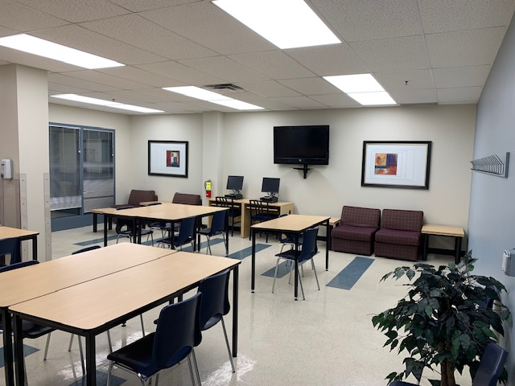
Basement B105 – Winnipeg Site
Student Lounge L34

Slide 34
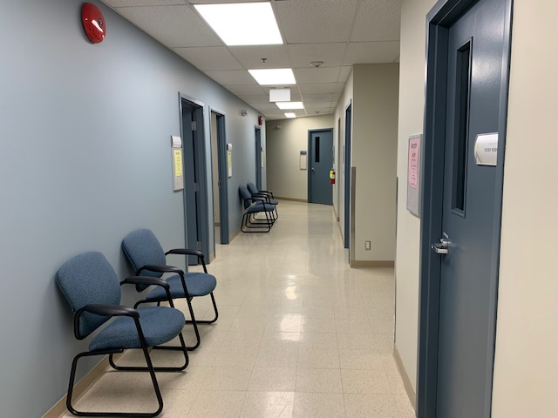
Basement B105 – Winnipeg Site
New Hallway leading to Basement Staff Lounge

Slide 35
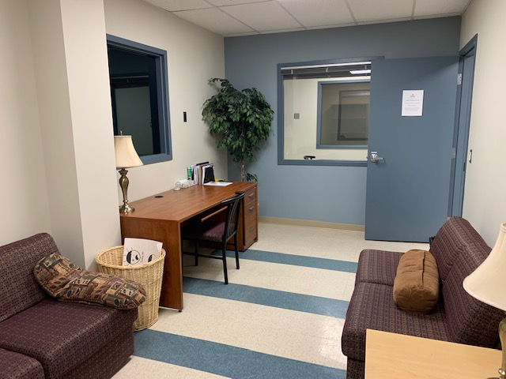
Basement B105 – Winnipeg Site
Family Counselling Room L22

Slide 36
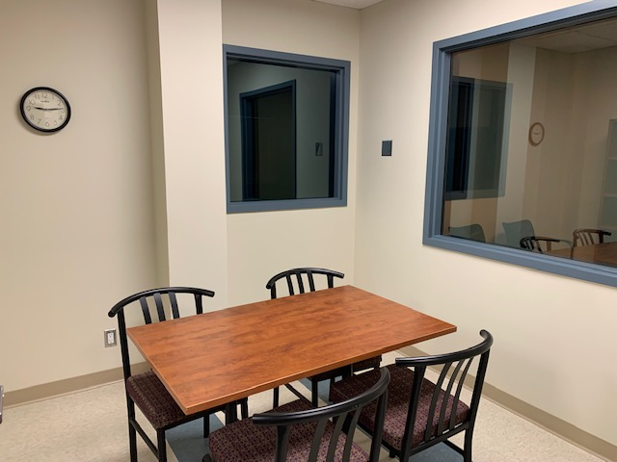
Basement B105 – Winnipeg Site
Observation Room L03

Slide 37
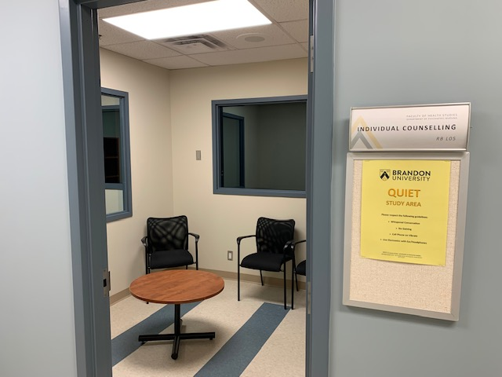
Basement B105 – Winnipeg Site
Individual Counselling Room L05

Slide 38
Winnipeg Campus
Expansion Project 2022
Visual Report and photos prepared by:
Chris byman
Administrative & technical resource assistant
Winnipeg campus

