Slide 1
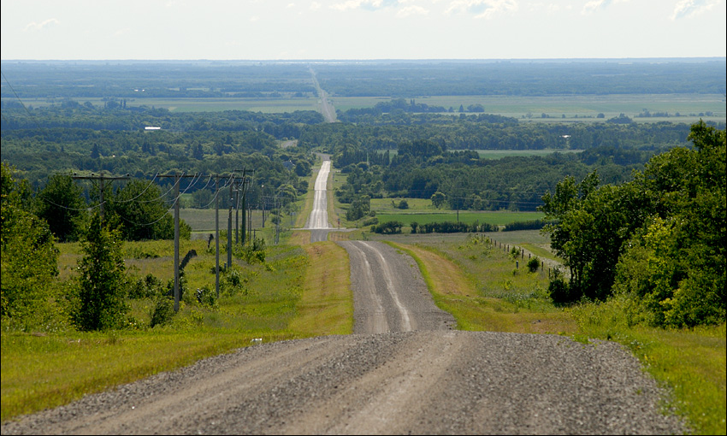
RPLC Webinar – September 12, 2017
Commercializing Food Innovation in Manitoba
Gillian Richards, PhD
Research Associate, Rural Development Institute
Brandon University, Brandon, MB Canada
204-571-8554 richardsgi@brandonu.ca

Slide 2
RIM Rural Innovation in Manitoba
Reducing Barriers to Commercialization and Growing Capacity in the Agri-food Sector
Research supported and funded by Growing Forward 2
The data, analysis of data, project analysis and conclusions or other information in this PowerPoint and webinar are those of the authors and the Rural Development Institute and not of the Government of Manitoba or Canada.
Commercializing Food Innovation in Manitoba

Slide 3
Partner Organizations
Commercializing Food Innovation in Manitoba

Slide 4
RIM Case-Studies
5 case-studies of commercialization of Manitoba food products
https://www.brandonu.ca/rdi/agro-environmental/rural-innovation-in-manitoba-reducing-barriers-to-commercialization-and-growing-capacity-in-the-agri-food-sector/
Company leaders
5 people or organizations who helped each
Crick Nutrition
The Canadian Birch Company
TWO CASES
Commercializing Food Innovation in Manitoba

Slide 5
Why Case-Studies?
Examples of how commercialization has worked - accessible
Sheds light on the key components and challenges during commercialization
Used to compare differences and similarities across companies
Shows what supports were used and how they were used
Shows how the support system can be strengthened
Commercializing Food Innovation in Manitoba

Slide 6
What is Commercialization?
Miriam Webster
To manage on a business basis for profit
English Oxford living Dictionaries
The process of managing or running something principally for financial gain
Oxford English Dictionary
To render commercial, make a matter of trade
Wikipedia
The process of introducing a new product or production method into commerce—making it available on the market.
Commercializing Food Innovation in Manitoba

Slide 7
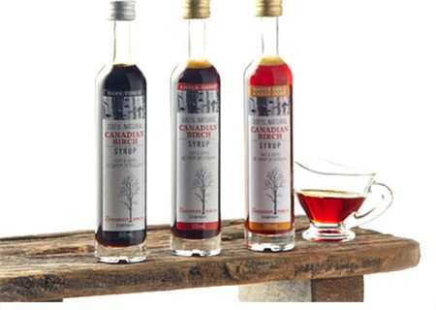
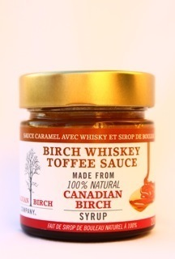
The Canadian Birch Company
Amber Gold Birch Syrup
Glenda & Rory Hart
Commercializing Food Innovation in Manitoba

Slide 8
Who helped?
5 stakeholders interviewed
Family member – Alan
Forestry Training Services (FTS) – Ken
Food Development Centre (FDC) – Alphonsus & Roberta
Women's Enterprise Centre Manitoba (WECM) – Nancy
PackEdge Designs – Sandra
Others
Commercializing Food Innovation in Manitoba

Slide 9
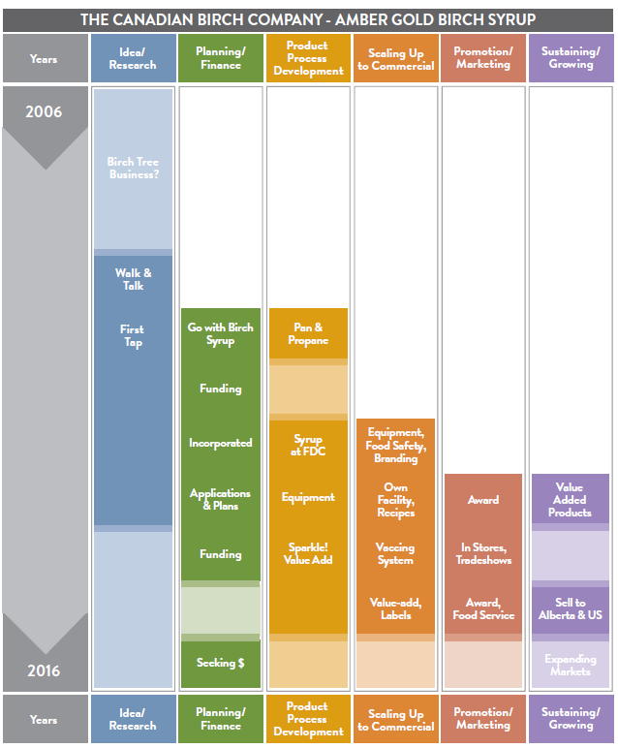
Commercialization Steps
Idea / Research
Planning / Finance
Product / Process Development
Scaling up to Commercial
Promotion / Marketing
Sustaining / Growing
Commercializing Food Innovation in Manitoba

Slide 10
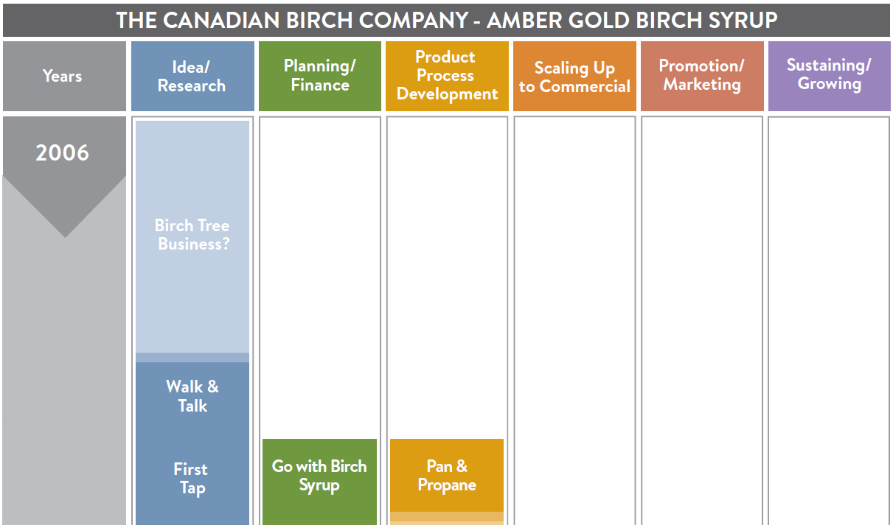
Canadian Birch Timeline
Glenda & Rory
Alan
Ken
2010
Commercializing Food Innovation in Manitoba

Slide 11
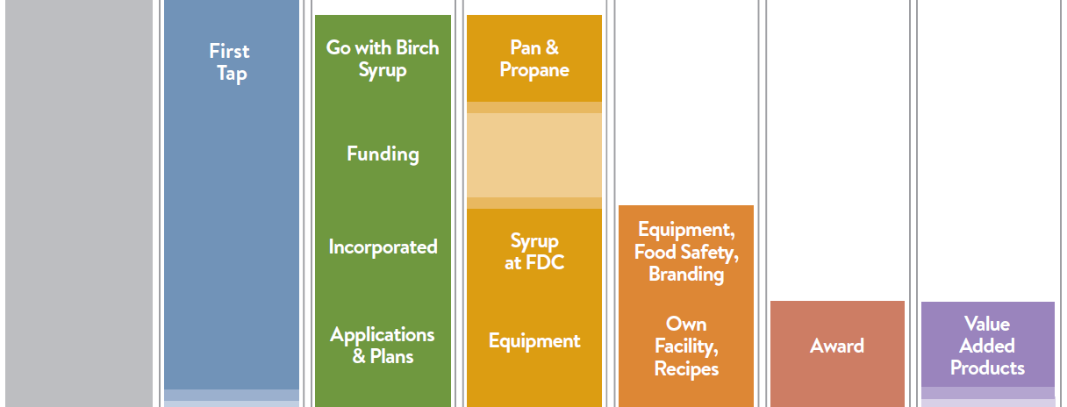
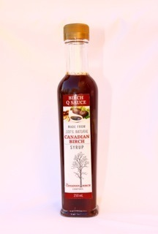
Canadian Birch Timeline
Alan
Ken
FDC
Sandy
WECM
Others
2010
2013
Purification
Concentration
Evaporation
Filtration
Bottling
Commercializing Food Innovation in Manitoba

Slide 12
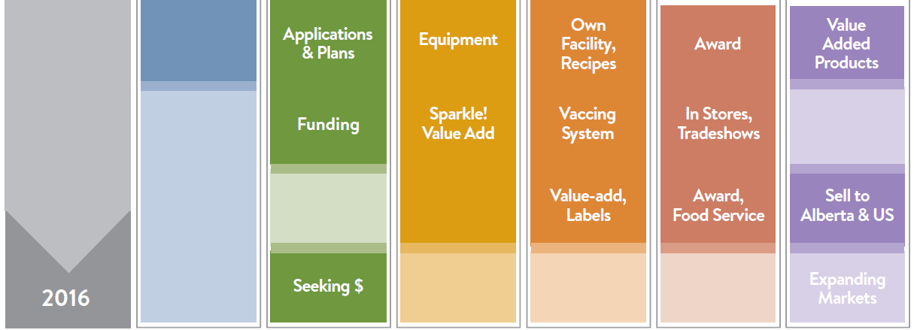
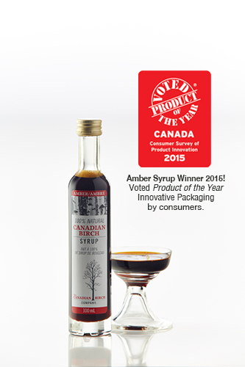
Canadian Birch Timeline
Alan
Ken
FDC
Sandy
WECM
Others
2013
Purification
Concentration
Evaporation
Filtration
Bottling
Commercializing Food Innovation in Manitoba

Slide 13
Canadian Birch Commercialization
10 years
Step-wise progression through commercialization
2010 to 2014 to establish facility and perfect process
Collecting + processing + bottling + selling
Added value products
Commercializing Food Innovation in Manitoba

Slide 14
Up Next – Crik Nutrition
Commercializing Food Innovation in Manitoba

Slide 15
Crik Nutrition
Cricket Based Protein Powder
Alex Drysdale
Commercializing Food Innovation in Manitoba

Slide 16
Who helped?
5 stakeholders interviewed
Entomo Farms – Jarrod
GFR Pharma Ltd. (GFR) – Julie
Futurpreneur – Joelle
North Forge (NF) – Jeff
Source Nutraceutical (SN) – Marcel
Others
Commercializing Food Innovation in Manitoba

Slide 17
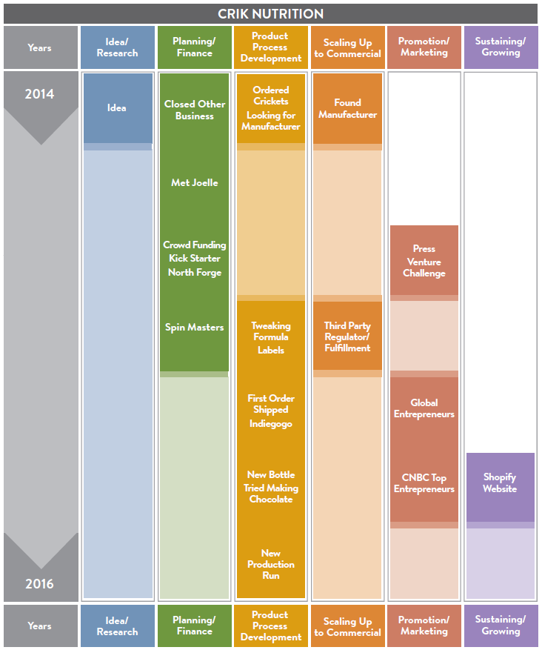
Commercialization Steps
Idea / Research
Planning / Finance
Product / Process Development
Scaling up to Commercial
Promotion / marketing
Sustaining / Growing
Commercializing Food Innovation in Manitoba

Slide 18
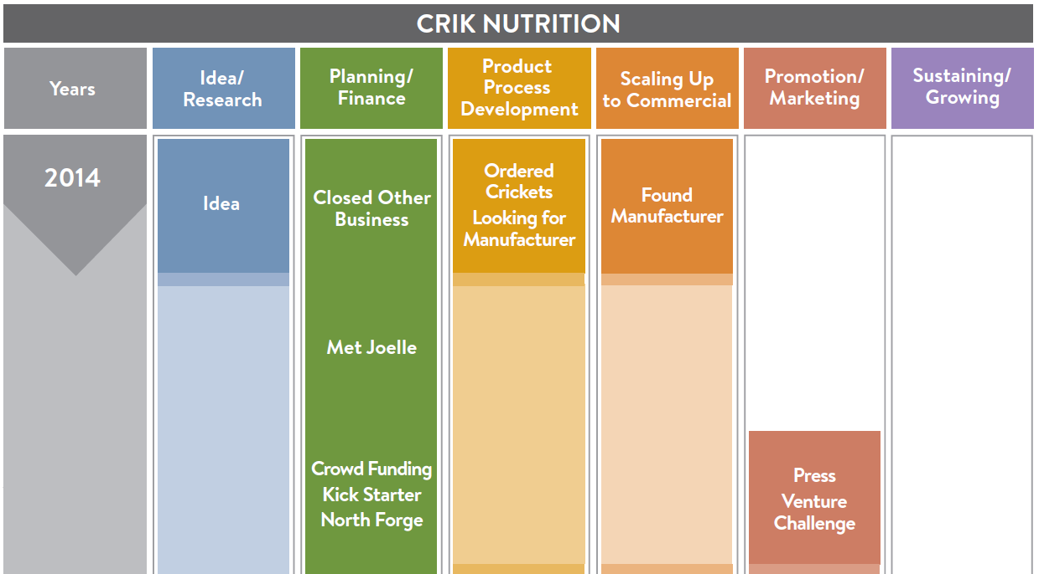
Crik Nutrition Timeline
Alex
Jarrod
GFR
Joelle
N Forge
Late
Mid 2015
2010
Commercializing Food Innovation in Manitoba

Slide 19
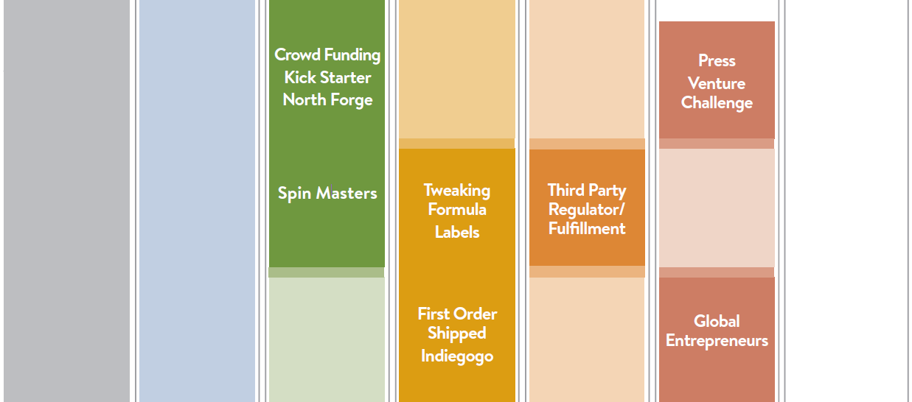
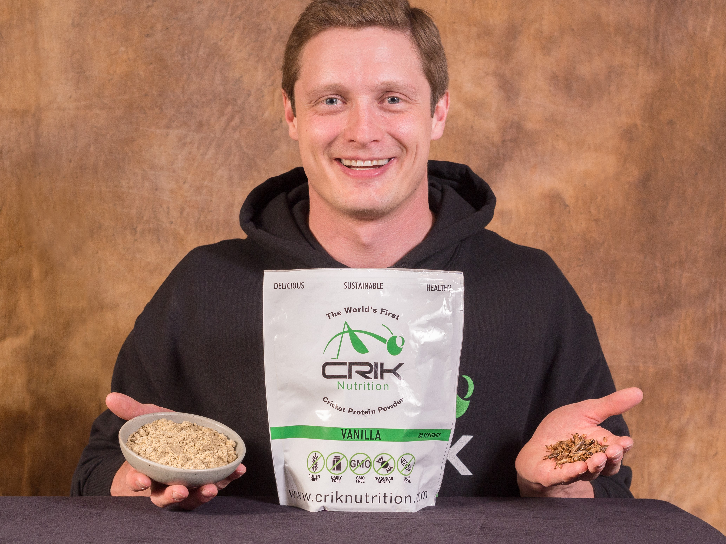
Crik Nutrition Timeline
Jarrod
GFR
Joelle
N Forge
Source N
Mid 2015
2010
Late 2015
Commercializing Food Innovation in Manitoba

Slide 20
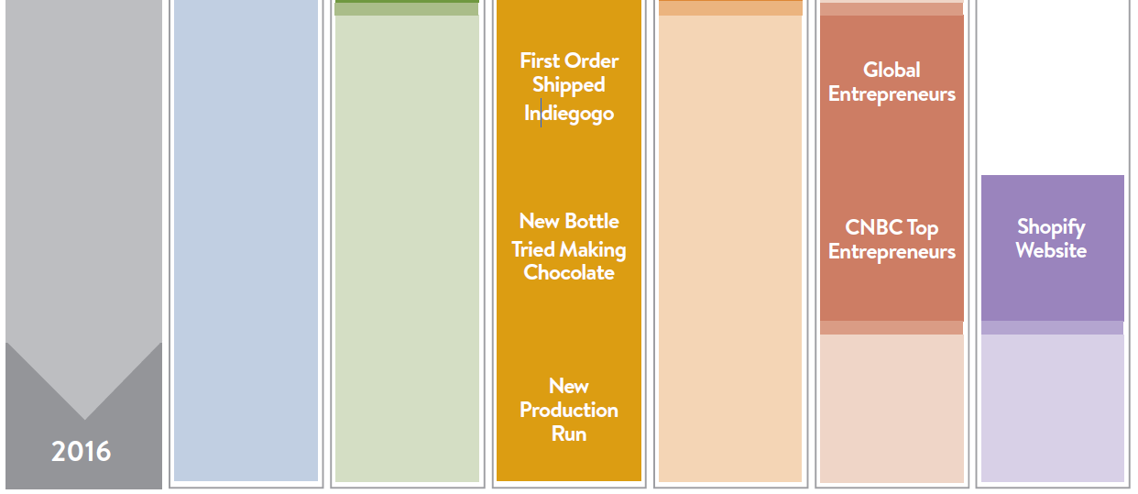
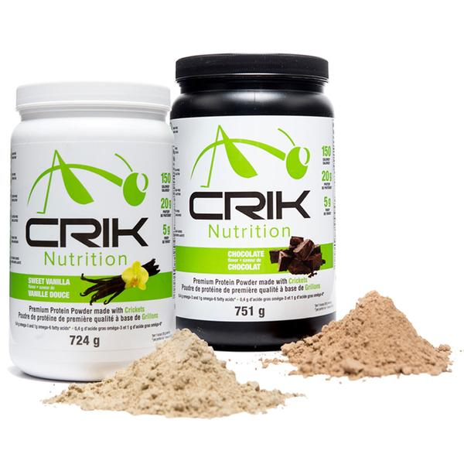
Crik Nutrition Timeline
Late 2015
Jarrod
GFR
Joelle
N Forge
Source N
2010
Commercializing Food Innovation in Manitoba

Slide 21
Crik Nutrition Commercialization
Less than 2 years from idea to sales
Concurrent progression through commercialization
2014 to 2016 to develop products and establish sales
Contract manufacture & packing, & distribution
Commercializing Food Innovation in Manitoba

Slide 22
Up Next: Comparison & Implications
Commercializing Food Innovation in Manitoba

Slide 23
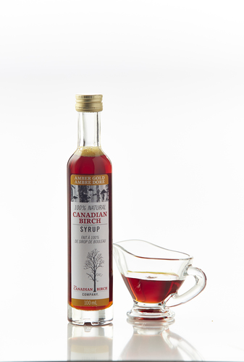
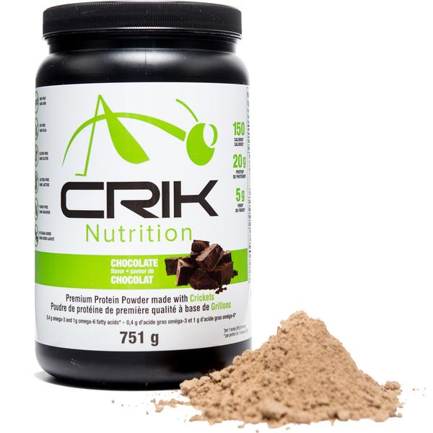
Similarities & Differences
Commercializing Food Innovation in Manitoba

Slide 24
Similarities
Innovative ingredients give novel product
Used multiple resources to help commercialize
Outside funding to assist commercialization
Little experience of food industry
Similar “stages” to commercialization, including product / process development
Challenge of ensuring balanced growth
Commercializing Food Innovation in Manitoba

Slide 25
Differences
Speed – time to commercialization
Step-wise or concurrent progress
Own facility OR contract
Tree to bottle or value chain
Level of business experience
Canadian Birch
Crik Nutrition
Commercializing Food Innovation in Manitoba

Slide 26
Stakeholders are:
Support organizations: government, NGO and commercial
Individuals and organizations closely associated with the company or the supply chain
Often provide specialized services – e.g. PPD, business advice & funding, branding
Are often involved with many aspects of commercialization in addition to a primary role including networking and sounding board.
Notes:
FROM PROPOSAL – INTRODUCTION

Slide 27
Commercializing a food innovation
In order to be competitive food processors need to:
Reliably provide a consistent high quality product, in the quantity the customer wants, delivered when they want it and at a competitive price.
Notes:
FROM PROPOSAL – INTRODUCTION

Slide 28
Commercializing a food innovation
In order to be competitive food processors need to:
Reliably provide a consistent high quality product, in the quantity the customer wants, delivered when they want it and at a competitive price.
Notes:
FROM PROPOSAL – INTRODUCTION

Slide 29
Commercializing a food innovation
In order to be competitive food processors need to:
Reliably provide a consistent high quality product, in the quantity the customer wants, delivered when they want it and at a competitive price.
Notes:
FROM PROPOSAL – INTRODUCTION

Slide 30
When does commercialization end?
To move beyond low volume sales:
Commercialization is not complete when a product is produced and introduced – it finishes when the innovation is profitable.
Support for innovators needs to continue beyond product launch. Help with scaling-up, especially with production at commercial efficiencies, branding and sales.
Commercializing Food Innovation in Manitoba

Slide 31
What Supports are Needed?
One size does not fit all
What is needed depends on each individual situation – the aims, skills and needs of innovators.
The support system needs to provide various kinds of support and guide innovators to the specialized support they need.
Commercializing Food Innovation in Manitoba

Slide 32
What are the Biggest Challenges?
Building capacity so supply, business skills, production, sales, and company capacity grow in a balanced way
Finding funding to enable balanced growth
Food companies is develop slower because equipment is specialized and expensive, and it is difficult to build sales.
Jumping the gap between small scale production and commercially efficient production
Commercializing Food Innovation in Manitoba

Slide 33
Thank you!

Slide 34
Alanna Keefe
Thoughts
and comments
Contact:
Alanna Keefe
Business Advisor and C3 Project Manager
Women’s Enterprise Centre Manitoba
204 988-1871
akeefe@wecm.ca

Slide 35
Questions?

Slide 36
Thank you!
Contact:
Gillian Richards
Rural Development Institute
Brandon University, Brandon, MB
204 571-8554
richardsgi@brandonu.ca

