Slide 1
Managing environmental issues –related to beef an international perspective
Tim McAllister
Lethbridge Research Centre
Agriculture & Agri-Food Canada

Slide 2
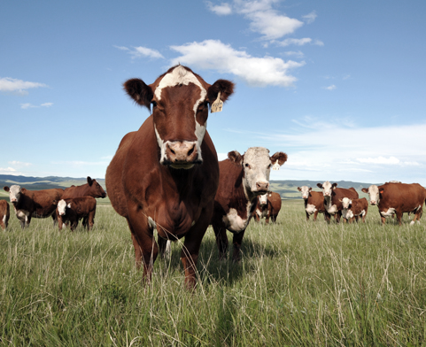
Implications of sustainability for the beef industry
Food
Safe
Security
Affordable
Environment
Sustainability
Economic
Notes:
In terms of sustainable livestock production for the future, I know you must have a lot of questions and comments about what I have said here today. Our tour job as scientists is to reveal the biology. But, it is going to take experts from many disciplines to decide the way forward, as this is not just a science issue.

Slide 3
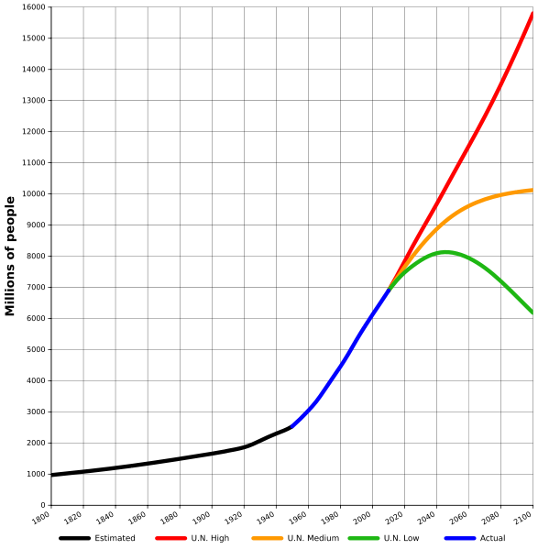
World population: 1800-2100 and projections (the variants)

Slide 4
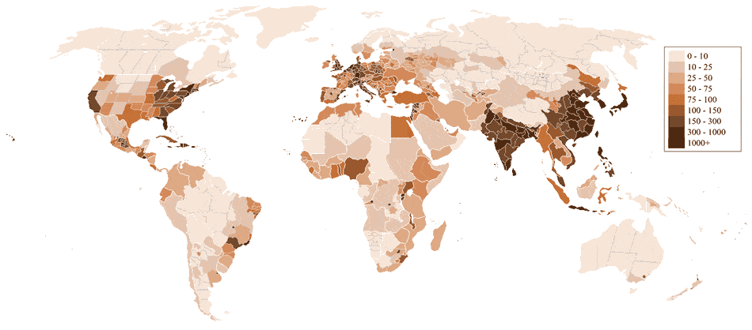
World population density 2012 (people/km²)

Slide 5
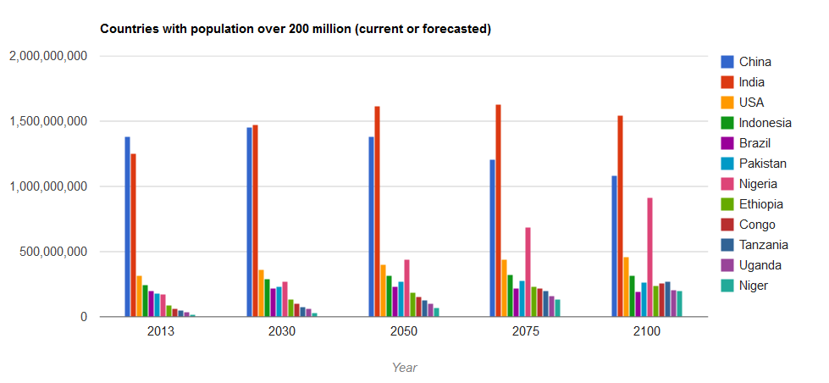

Slide 6
Gapminder World Demonstration

Slide 7
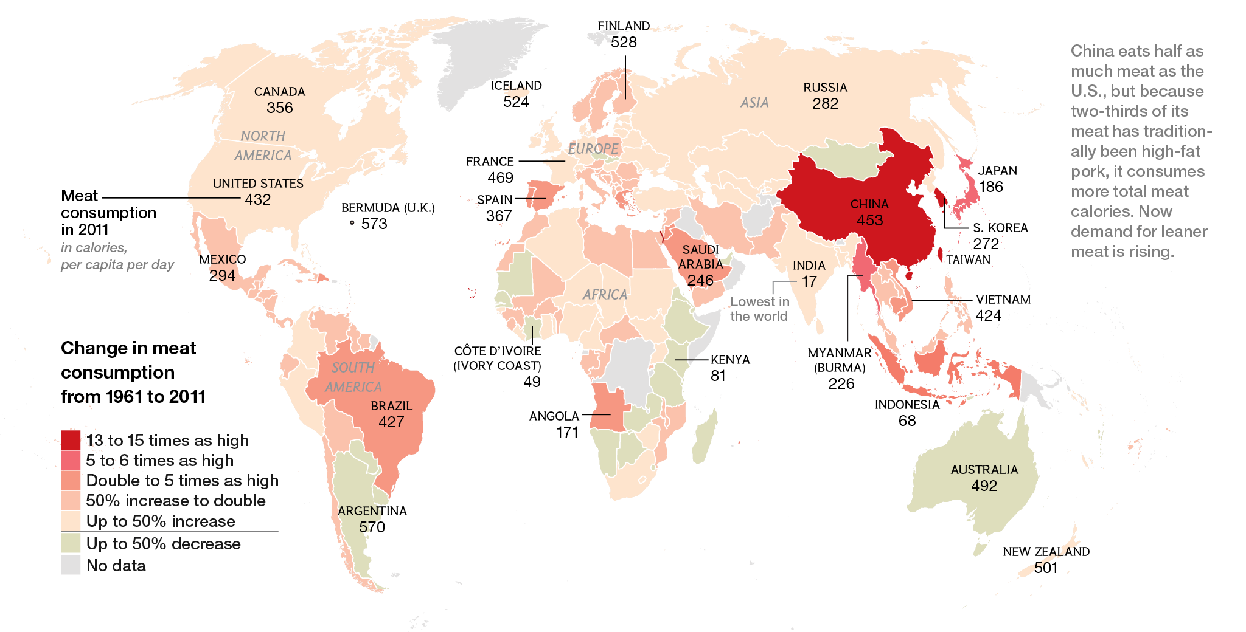
National Geographic 2014

Slide 8
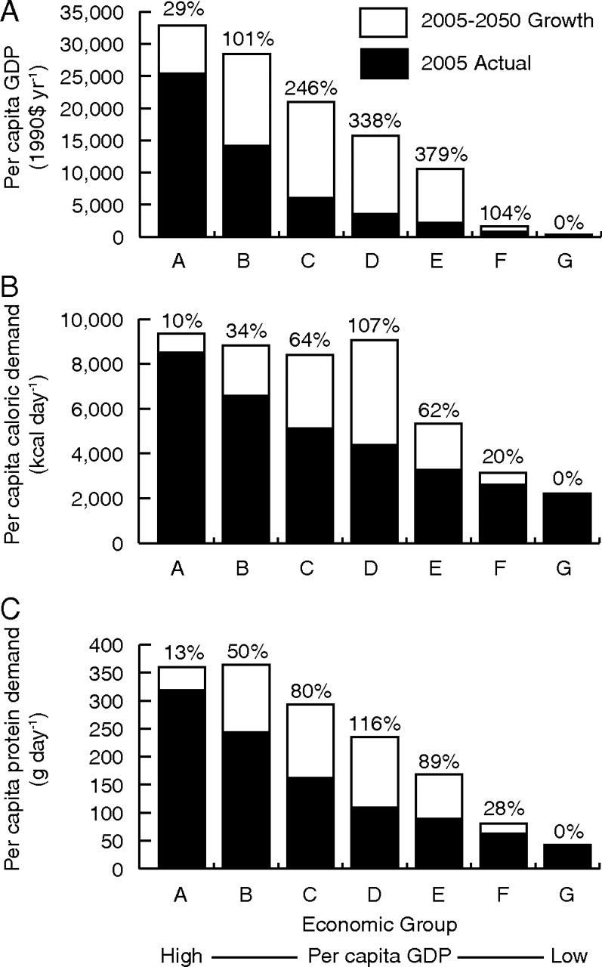
Per capita GDP
Per capita crop calories
Per capita crop protein
(A) Per capita GDP, (B) per capita demand for crop calories, and (C) per capita demand for crop protein in 2005 (black) and mean projected 2050 increases (white; percent increases above bars).
Tilman D et al. PNAS 2011;108:20260-20264
Notes:
(A) Per capita GDP, (B) per capita demand for crop calories, and (C) per capita demand for crop protein in 2005 (black) and mean projected 2050 increases (white; percent increases above bars).

Slide 9
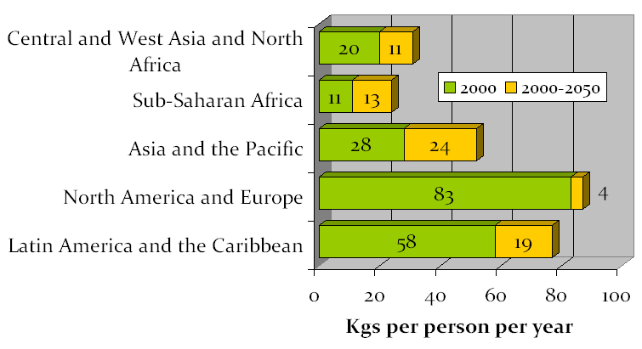
Per capita meat consumption, 2000-2050
Source: IFPRI IMPACT projections, September 2007

Slide 10
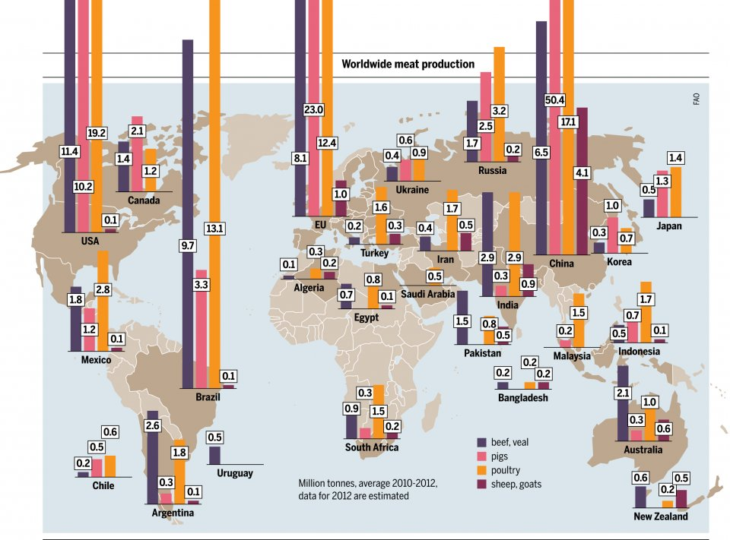

Slide 11
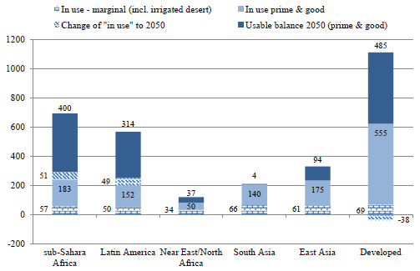
Land in use at present, increase to 2050 and remaining balance in 2050

Slide 12
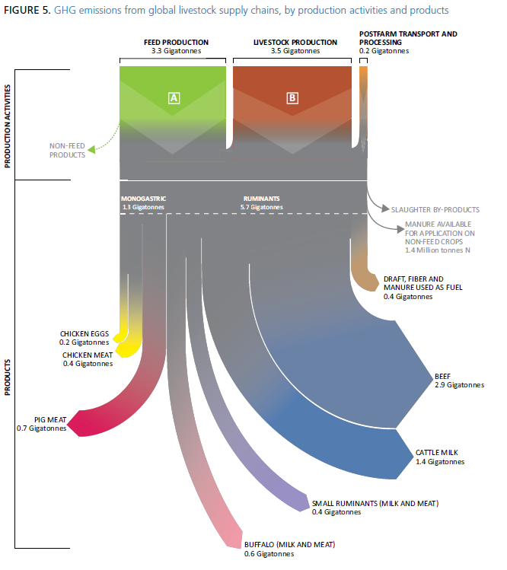
GHG emissions from global livestock supply chains, by productions activities and products

Slide 13
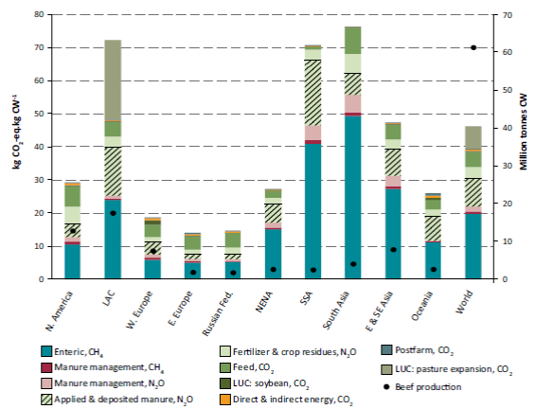
Regional variation in beef production and GHG intensities
Source: GLEAM

Slide 14

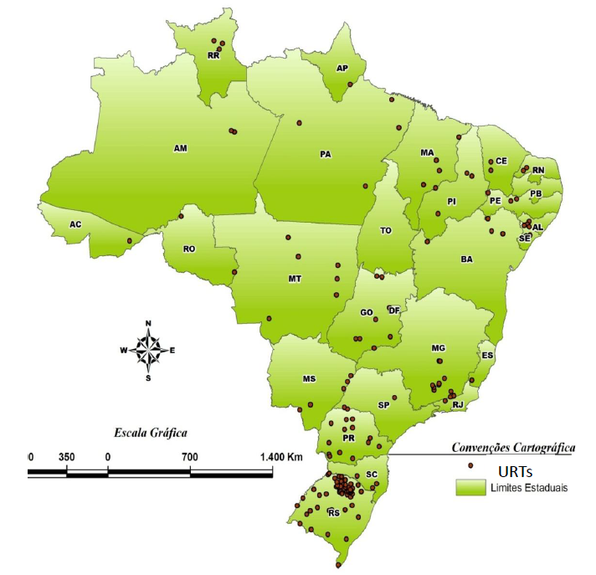
A Brazilian example: capacity strengthening and TT
194 “pilot-units” coordinated by Empraba (2011)

Slide 15

A Brazilian example:
capacity strengthening and TT
365%
10X
Worlds largest exporter
Total crop production
(1996-2006)
Beef exports
(tenfold increase)
Beef, poultry and sugar cane

Slide 16
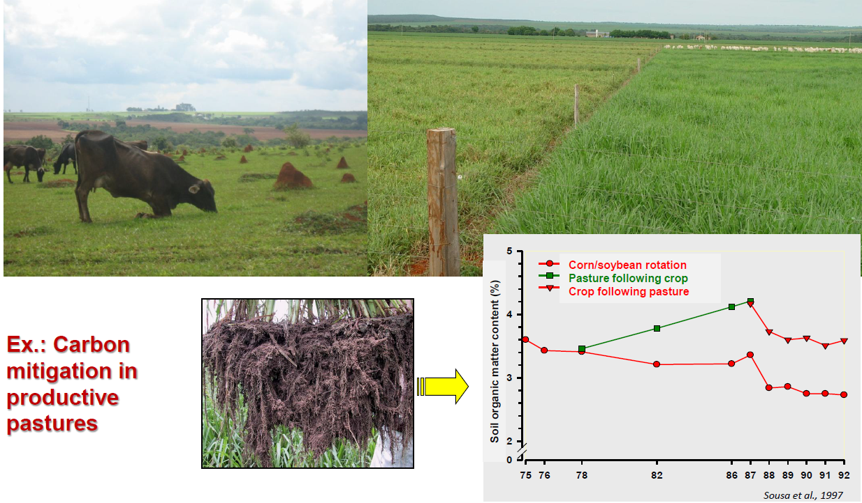
Restoring value to grasslands
years

Slide 17
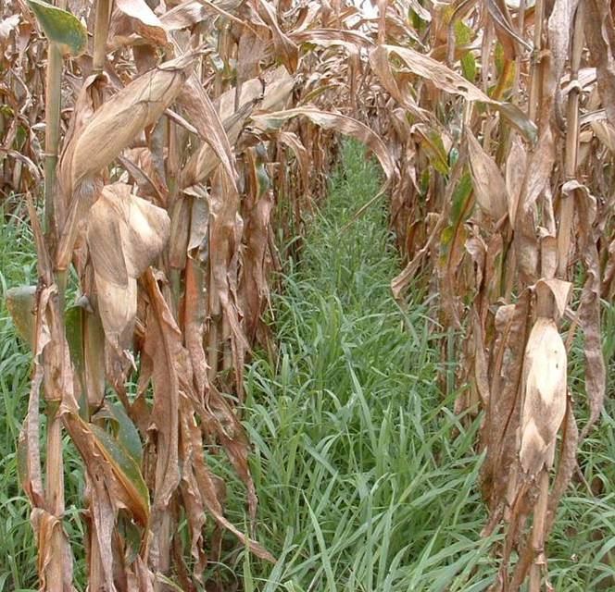
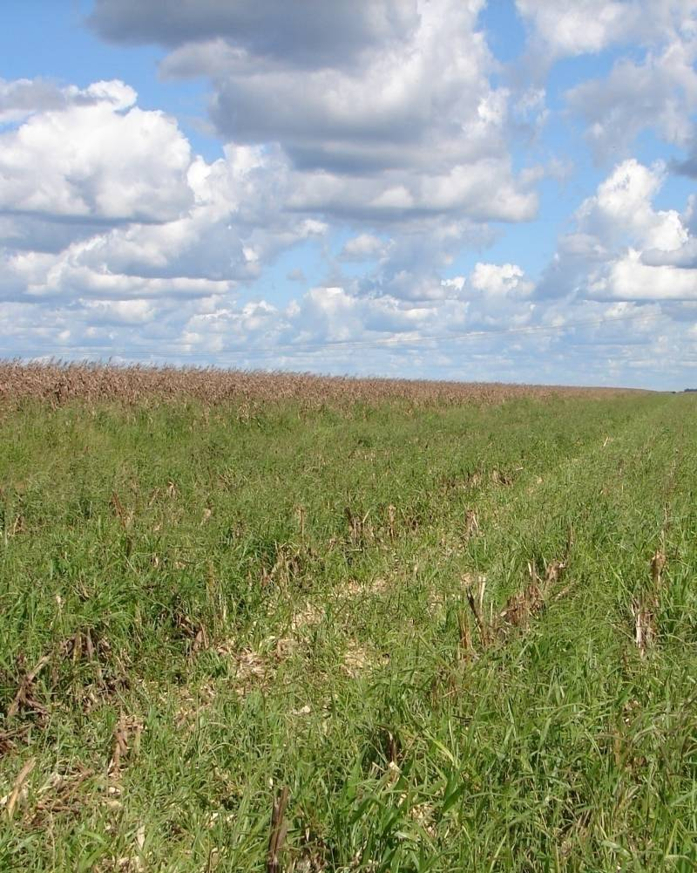

Slide 18
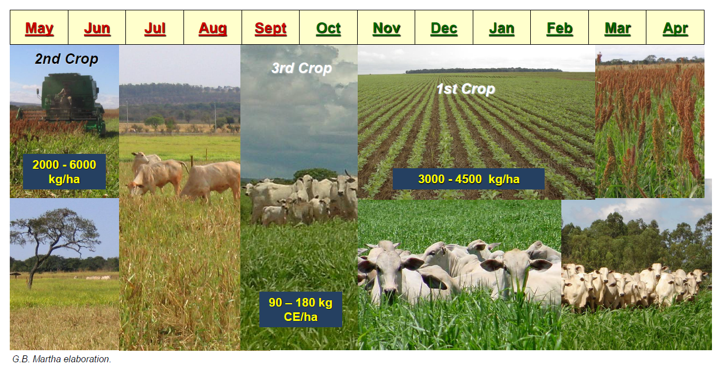
Restoring value to grasslands
Increasing cropping intensity

Slide 19
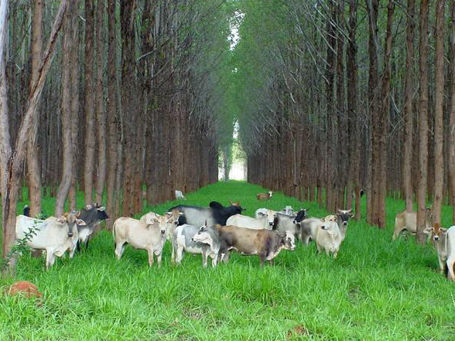

Slide 20
Brazil’s Forest Code
Landowners must conserve a percentage of their terrain forested
  80% Amazon area
  35% Cerrado area
  20% other parts of Brazil
Permanent preservation areas
  Springs
  River borders
  Areas with declivity > 45º
  top of hills (higher than 100 m)
  areas with altitude higher than 1800 m

Slide 21
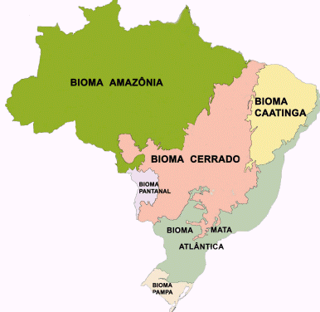
Brazil’s Forest Code
80%
20%
35%
20%
20%

Slide 22
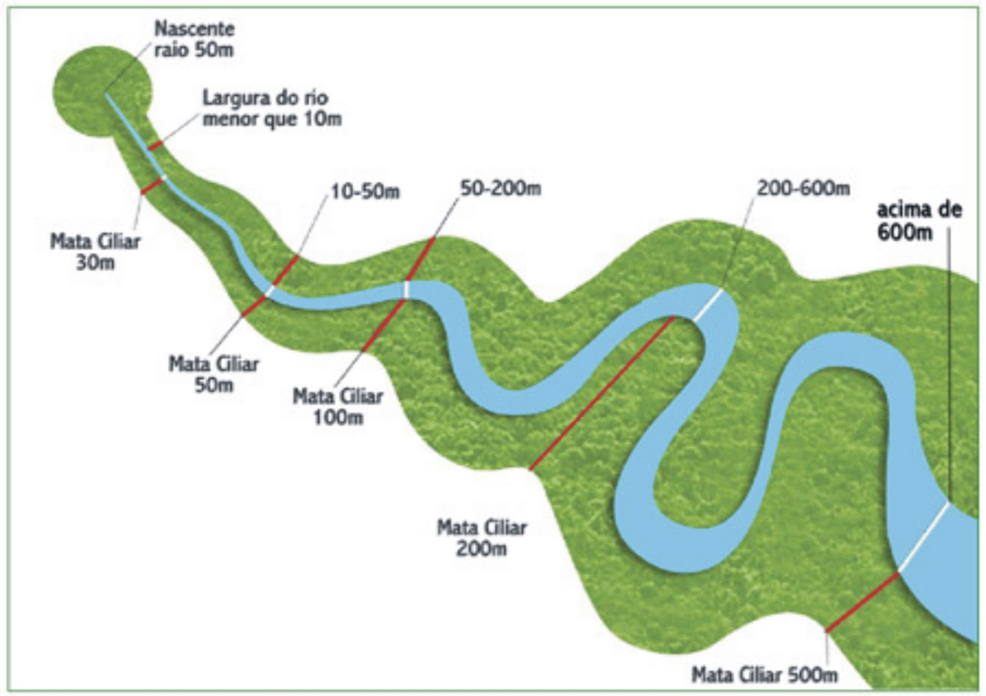
Brazil’s Forest Code
Spring
50 m of radius
Nº 12.651, May 25th of 2012

Slide 23
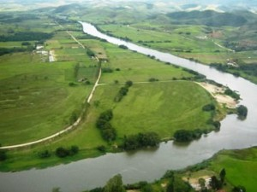
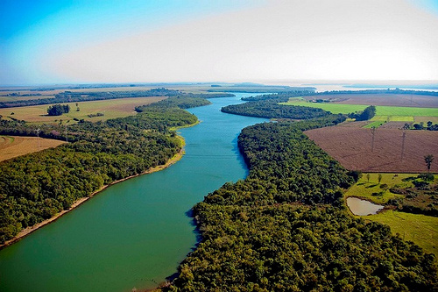
Brazil’s Forest Code
X

Slide 24
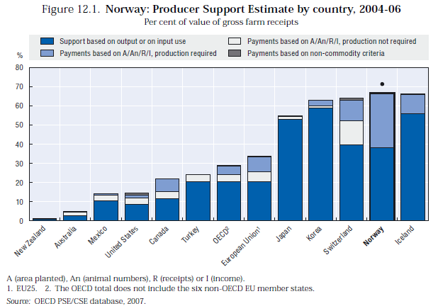

Slide 25
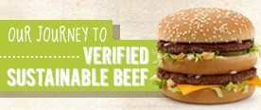
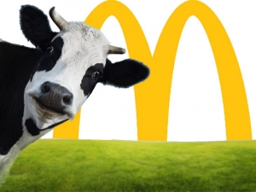
Our Aspiration
Develop global principles and criteria in 2014
Develop targets for purchasing verified sustainable beef
Begin purchasing in 2016
Our Vision
Production systems that:
  Optimize cattle's impact within ecosystems and nutrient cycles
  Positively impact the lives of their employees and the communities in which they operate
  Care for the welfare of the cattle throughout their lives
Our Approach
Create principles and criteria for sustainable beef production
Identify and test sustainable beef production practices
Lead with transparency and engagement
Work closely with suppliers and partners for industry change

Slide 26

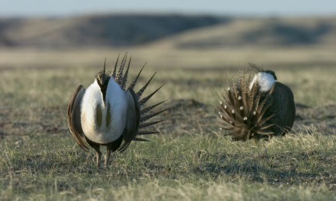
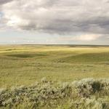
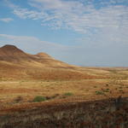
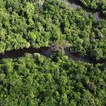
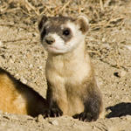

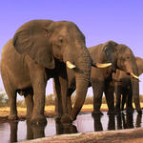
Water pollution and usage
  Surface water
  Sediment from erosion
  Overall water use
Industrial pollution
  Waste from slaughterhouses/tanery
Soil degradation
  Contribution to soil erosion
  Deforestation
  Soil compaction
Climate change
  Greenhouse gas emissions
  Carbon loss

Slide 27







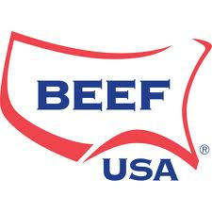








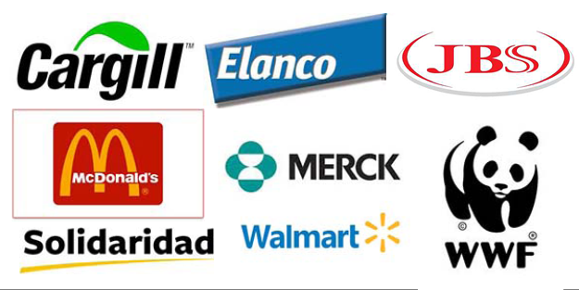




“We envision a world in which all aspects of the beef value chain are environmentally sound, socially responsible and economically viable."
"The GRSB mission is to advance continuous improvement in sustainability of the global beef value chain through leadership, science and multi-stakeholder engagement and collaboration."

Slide 28
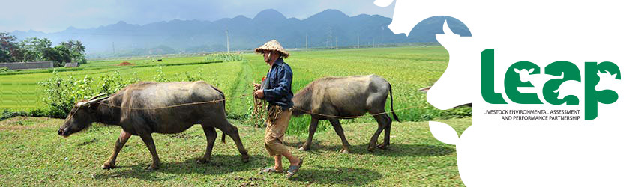

Livestock Environmental Assessment and Performance (LEAP) Partnership

Slide 29


Beef production & efficiency
Each point of beef produced in the USA today requires:
  30% less animals

Slide 30


Beef production & efficiency
Each point of beef produced in the USA today requires:
  30% less animals
  14% less water
1977
14% less
2007

Slide 31
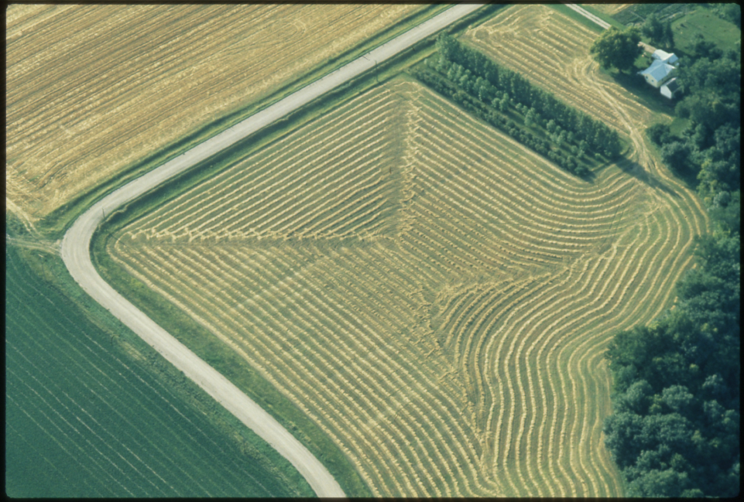
Beef production & efficiency
Each point of beef produced in the USA today requires:
  30% less animals
  14% less water
  34% less land
34% less
1977
2007

Slide 32

Beef production & efficiency
Each point of beef produced in the USA today requires:
  30% less animals
  14% less water
  34% less land
  18% smaller carbon footprint
2007
18%
1977

Slide 33
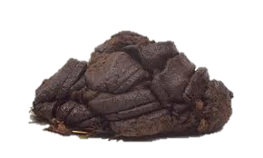
Beef production & efficiency
Each point of beef produced in the USA today requires:
  30% less animals
  14% less water
  34% less land
  18% smaller carbon footprint
  Generate 20% less manure
20% less
1977
2007

Slide 34
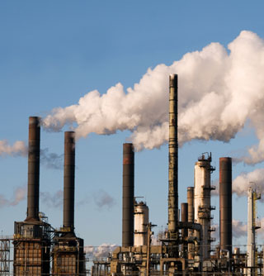
Beef production & efficiency
Each point of beef produced in the USA today requires:
  30% less animals
  14% less water
  34% less land
  18% smaller carbon footprint
  Generate 20% less manure
  16% less greenhouse gas emissions
16% less
1977
2007

Slide 35
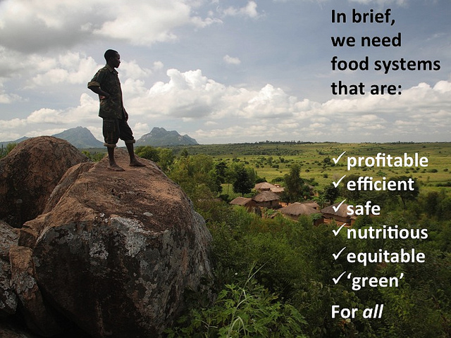

Slide 36
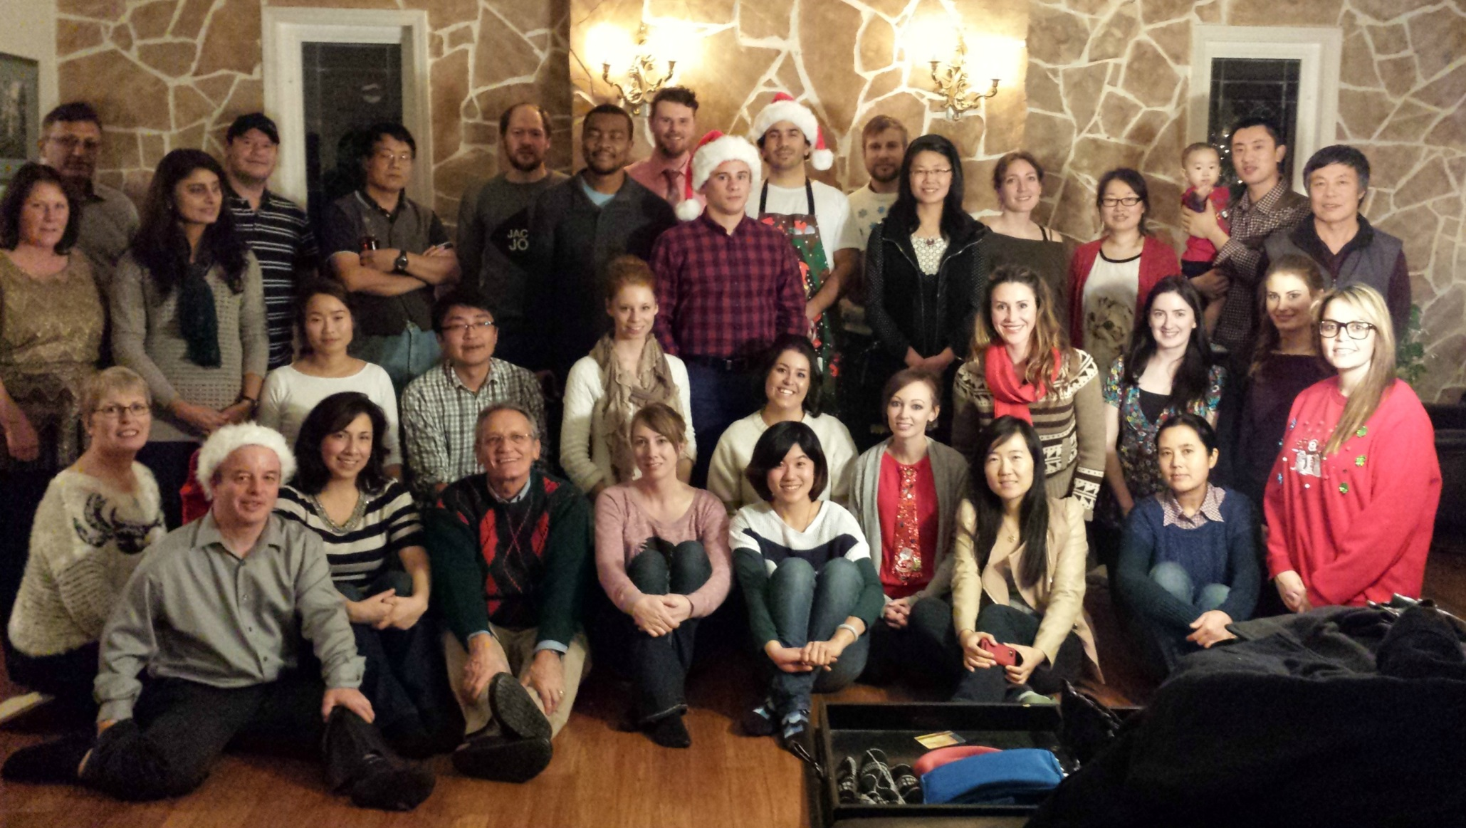
The McAllister Team
2013

Slide 37
Thank you
Questions?

Slide 38
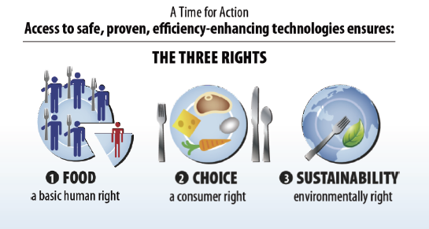
Notes:
Taste, Price, Nutrition and life style.
Safe, Affordable and abundant food

Slide 39
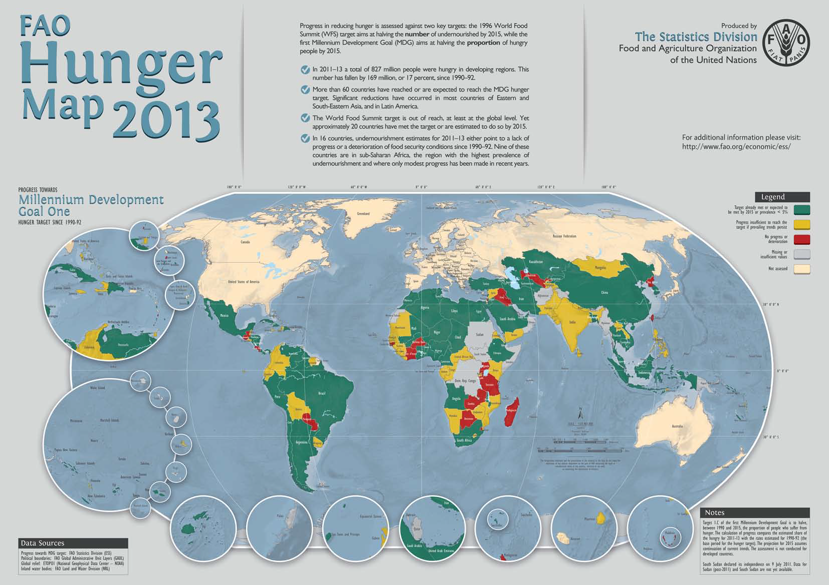

Slide 40
Real world meat prices projected to rise
20-30% beyond current high levels
Meat
Source: IFPRI

Slide 41
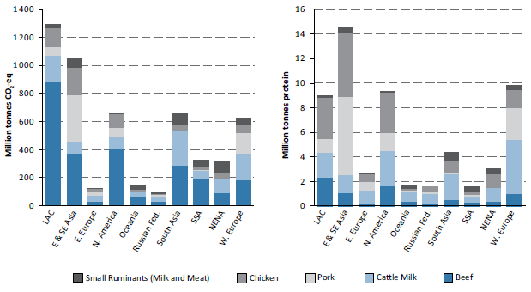
Global livestock production and GHG emissions from livestock, by commodity and regions

