Slide 1
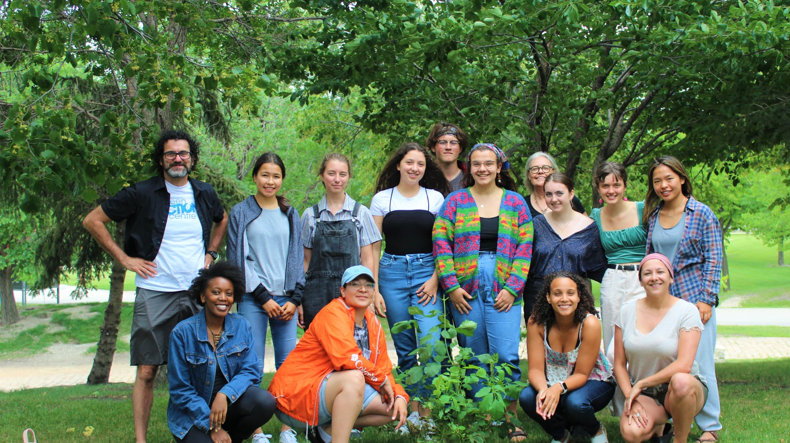
Nurturing wellbeing in rural Manitoba
Presented by:
Courtney Feldman, Capacity Building Lead, Endow Manitoba
Iain Cowie, Community Researcher, Rural Development Institute
June 21, 2023

Slide 2
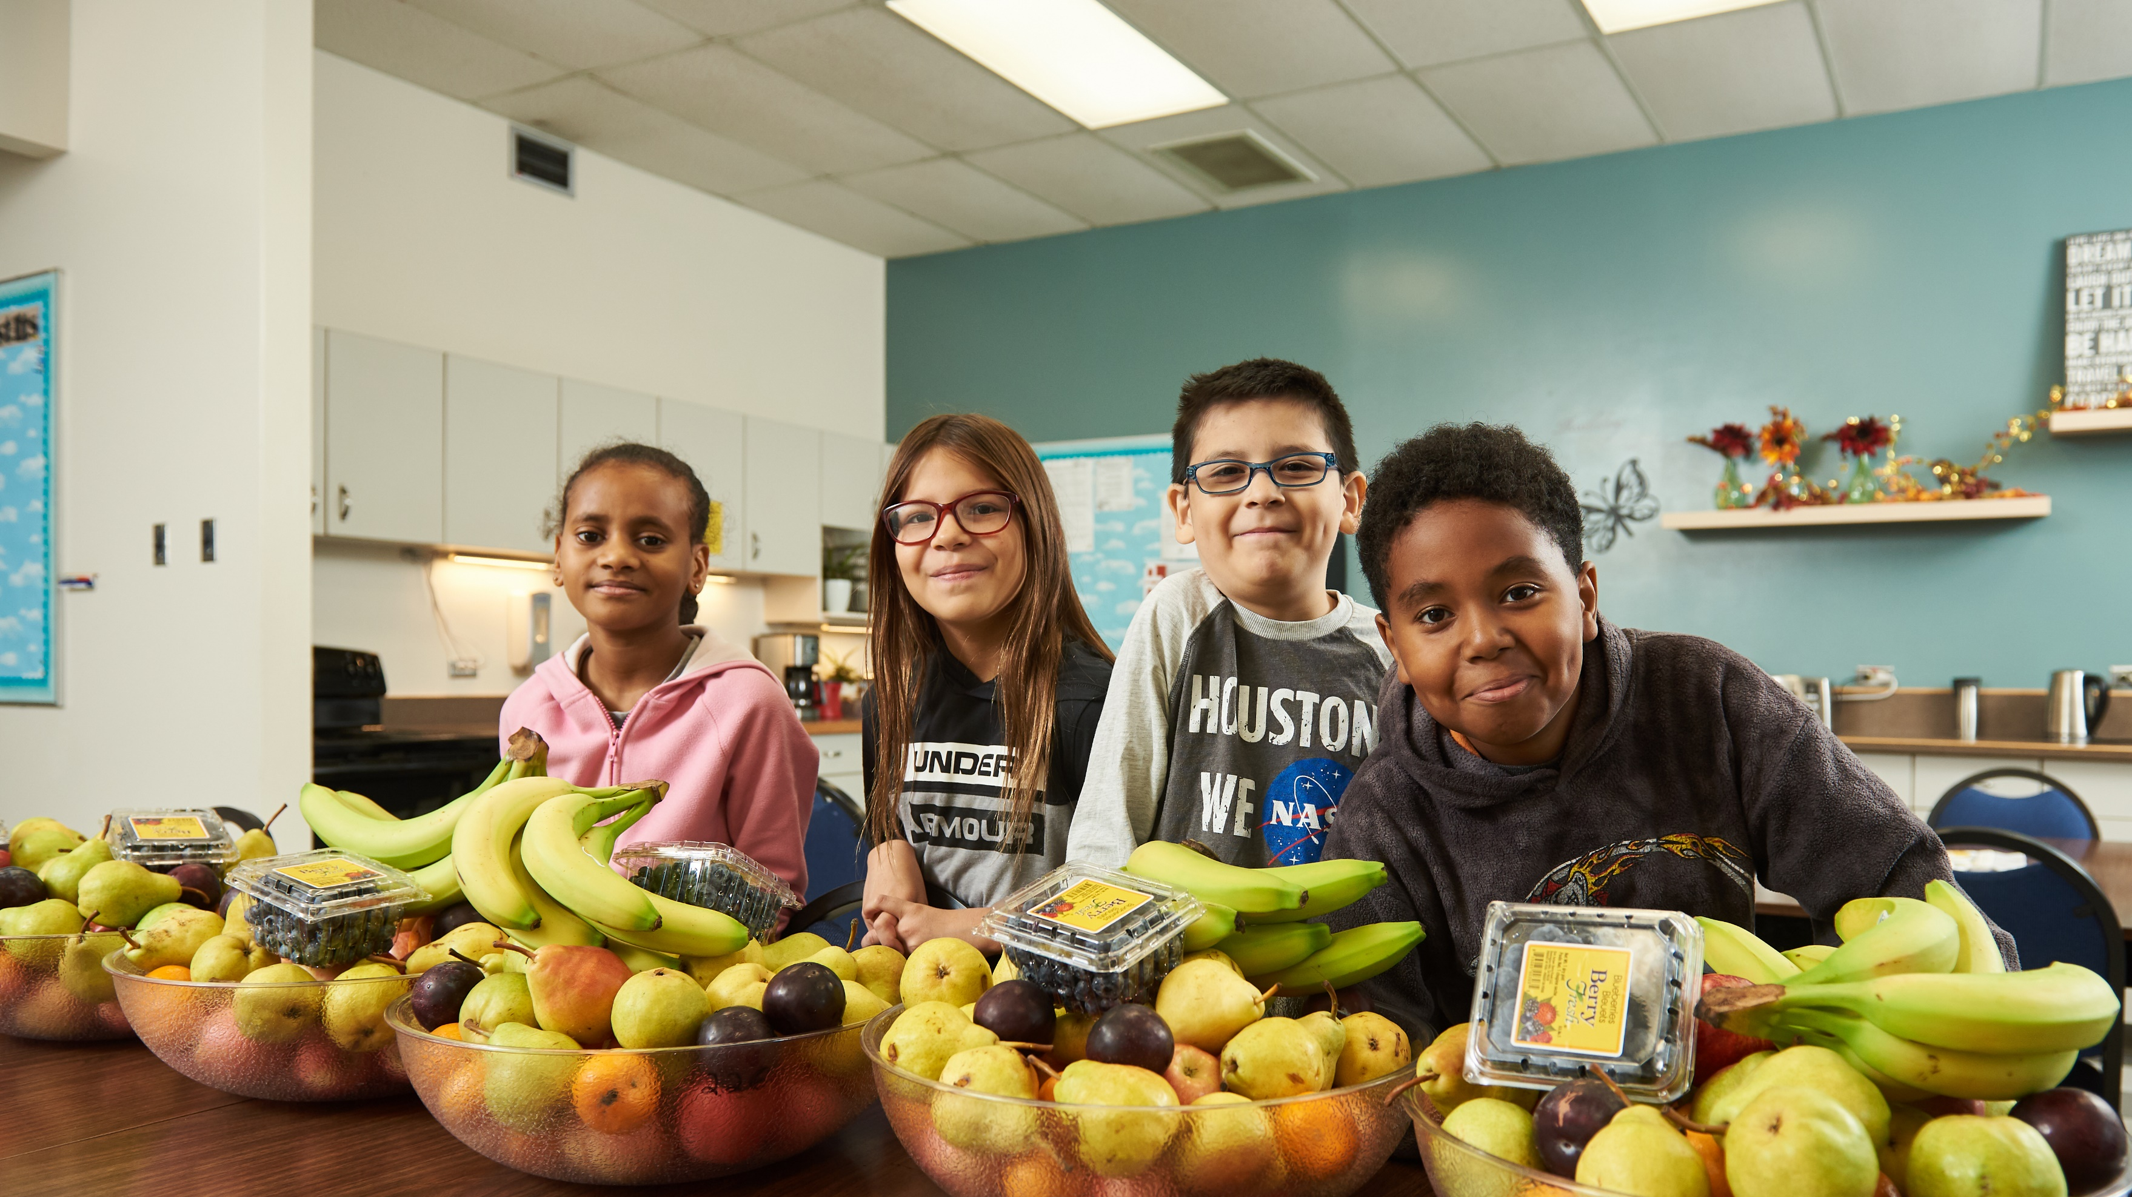
What are contributors to enhancing community wellbeing?
Notes:
A reflective question, to get thinking on topic. Many responses will have come up throughout the conference, there isn't one right/sole answer.
[Possible responses: sense of belonging, access to health care, economic vibrancy, community knowledge, etc.]
No time to share answers, but make a mental note of what your list. We will return to this list shortly.

Slide 3
Community Foundations
Governed by local leadership, building transparency, accountability, and trust in processes.
Act as a community leader to convene, connect, and better understand wellbeing priorities.
In a climate of fiscal constraint, they build relationships to secure funding for community priorities.
Notes:
I come to this conversation looking at this question through a philanthropic lens, more specifically, the role a CF plays in enhancing community wellbeing. Or the role a CF can play in supporting the responses to the question you all gathered (the list in your head!). To summarize rather complex organizations – review bullets.

Slide 4
Sustainability, Growth, and Impact Model
Operational
(outward facing)
Governance
Donor Stewardship
Fund Structures
Donor Prospects & Allies
Fund Goals & Growth Strategy
How do you define success?
What contributes to your success?
Board of Directors
Committees
Bylaws & Policies
Vision, Mission & Values
Strategy & Risk
Fund Development
Finance & Administration
Governance
Grant Application
Grant Making
Grant Awarding
Grant Reporting
Cumulative Grants Impact
Grant Making
Fund Accounting
Sustainable Fund Strategy
Budget
Human Resources
Office Space
Information Technology
Operational Risk
Finance & Administration
Communications
Convening & Engagement
Community Research
Partnerships & Collaboration
Projects & Programs
Strategic Initiatives
Notes:
My role, at Endow Manitoba, an initiative of The Winnipeg Foundation is to advance the sustainability, growth and impact of the 57 CFs in MB, who are all working to enhance community wellbeing, throughout our province. (unique landscape in MB, similar here in AB, Canada over 200 CFs – coast to coast to coast, coverage, expanding access to the movement in strategic ways).
To do this work, we first asked MB CFs (and other stakeholders) how do you define your success? What contributes to your success?
From these responses, we build a model, or a framework/roadmap that directs our work.
It holds inward facing activities. Governance and Finance & Administration.
It also holds outward facing activities. Fund Development. Grant Making. And strategic initiatives - which is the focus function today – also known as community leadership, this function connects directly with community. (Review what it holds.)

Slide 5
Sustainability, Growth, and Impact Model
“Capacity Stages”
Staff supported by volunteer 'policy' focused board
Review of polices and practices complemented by strategic planning
Decisions flow from evidence-based understanding of community
Community partnerships and collaborations are sought
Staff supported by volunteer managing board
Review and refinement of policies and practices
Intentionality in building relationships and accessibility
Accelerating
Developing
Volunteer working board
Foundational policies and processes
Passive and reactive
Emerging
Notes:
We know not all CFs operate at the same level, and each will develop and mature at its own pace.
So layered onto this model are stages of capacity, different capacity levels are found across Manitoba within the landscape of community foundations.
Share examples of what this looks like.

Slide 6
How can we support and expand the community leadership work of community foundation?
Notes:
The question we, at Endow Manitoba were asking is, How can we expand the community foundation's to think about their role, their community leadership role in the community and what this looks like. Pushing the to think about that strategic initiatives function I mentioned.
We wanted to explore ways to shift from a historical view of the role or how a community foundation engages wellbeing. A community foundation's role is more than a community bank account. And that if we explored the leadership activities of a community foundation we would find core supports to the responses of our original question – things like networks, coalitions, partnerships, collaboration, community knowledge, collaborative action, and much more. There is knowledge and great work out there related to good governance practices, support for building accountability and efficiency into administrative practices, donor stewardship initiatives, and granting decisions – but less was known about research, convening, engagement, generating community knowledge.
To help us with this question, we turned to RDI at Brandon University.

Slide 7
RURAL DEVELOPMENT INSTITUTE
Methods and Process
Scoping Review
Mapping key concepts and themes associated with the Strategic Initiatives function
Broadness of the scoping review
Rural community foundations, are underrepresented in literature.
Nurturing Wellbeing in Rural Manitoba

Slide 8
Key Findings
Wellbeing
Leadership
Inclusion
Emerging
Developing
Accelerating
Capacity
Notes:
We didn’t go into this project thinking and talking about wellbeing, but it quickly emerged as the overarching theme.
We observed that wellbeing in the literature is all encompassing, holding multiple definitions, making it comprehensive in nature.
Toss to Courtney for comment re: implication of this finding. (Courtney: it is at the core, grounding us in our work.)
There were also two key principles that emerged from the literature that we would like to highlight. Leadership and inclusion.
- Leadership, noted as critical to supporting CFs in being an effective catalyst or agent of community change, it looks and feels different in each organization, and essentially encompasses the notion that we cannot (and should not) do this work alone.
Inclusion, noted as the ability and willingness to reach and actively involve the communities and individuals served, all members of the community – used by CFs to create a sense of belonging, an understanding of what voices are not being heard.
Another important finding, which aligned with the capacity model that Courtney mentioned with their Sustainability, Growth and Impact, is a continuum of capacity – leadership doesn’t show up in one way, one and done, this way and that it. That same goes for diversity and inclusive practices. The capacity of the community, organization, and individual impacts and influences how leadership and diversity and inclusive practices show up in the organizations/community foundations.
The interconnectedness of these three overarching principles to each other and their collective relationship to the core concept of wellbeing cannot be overstated. A Community Foundation’s ability to enhance their community’s wellbeing will be determined by its leadership, diversity and inclusion and capacity. Put another way, each of the three overarching principles have an influential impact on the other two and all three impact a CFs ability to enhance wellbeing over the short, medium and long term.

Slide 9
Implications
Expanding view of community
We cannot grant our way out of social problems
Intentional convening with community
Raising awareness and understanding of social priorities
Sparking collaborative action
Notes:
Confirmed that the traditional or more reactive approach of community foundations enhancing community wellbeing – which is perhaps not as inclusive or connected to the community being served, wasn’t enough. We now know better (through this process and its finding) so we now need to do better.
Simply put, we can’t grant our way out of social problems. Money alone will not move the needle or enhance community wellbeing.
What is Endow Manitoba doing?
Expanding view of community – introducing wellbeing framework, comprehensive, inclusive so all community members can see themselves in their community
Intentional convening – depending upon capacity of the CF and the community, we are supporting intentional engagement with community – who isn't in the Tipi that should be in the Tipi, bringing the network together to talk about these critical issues (to explore them together)
Raising awareness and understanding of social priorities – again depending on capacity of CF and community, working with CFs to generate meaningful community data
Sparking collaborative action: People becoming more aware of their social priorities so they can work together.

Slide 10
What information should we be gathering?
What questions should we be asking our community?
What voices haven’t we heard from?
Other than granting, how can we use this information we are gathering?
Notes:
Over the last 3 years, it isn’t Endow asking how do we support CFs to explore the leadership or strategic initiatives function of a community foundation – but community foundations are now asking us…what we think, are all the right questions!

Slide 11
RURAL DEVELOPMENT INSTITUTE
Next Steps for Rural Researchers
Continued collaboration and partnership
Addressing gaps in the existing literature
Emphasis on wellbeing
Nurturing Wellbeing in Rural Manitoba

Slide 12
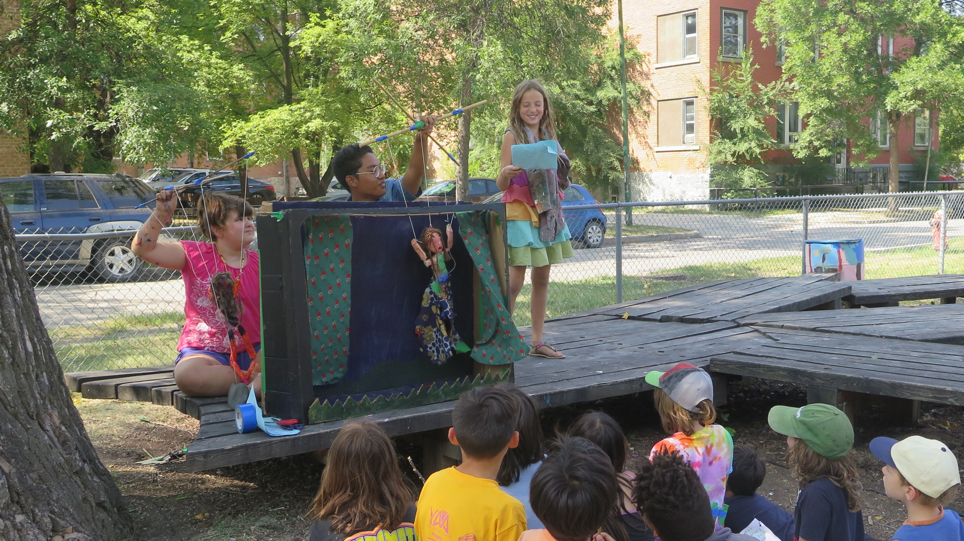
Thank you

Slide 13
Key References
Bingle, B. (2019). Capacity-Building Catalysts: A Qualitative Assessment of Nonprofit Capacity Building by Community Foundations in Illinois. The Foundation Review, 11(4), 68, 70, 73, 74, 77-79. https://doi.org/10.9707/1944-5660.1494
Chandler, J., & Scott Kennedy, K. (n.d.). A Network Approach to Capacity Building. National Council of Nonprofits. https://www.councilofnonprofits.org/tools-resources/network-approach-capacity-building.
Cheuy, S. (2018) "Community engagement: a foundational practice of community change". Retrieved from: https://www.everychildcq.org/wp-content/uploads/2018/06/Community-Engagement-A-Foundational-Practice-of-Community-Change-Sylvia-Cheuy.pdf
Cornforth, C., & Mordaunt, J. (2011). Organisational Capacity Building: Understanding the Dilemmas for Foundations of Intervening in Small- and Medium-Size Charities. Voluntas: International Journal of Voluntary and Nonprofit Organizations, 22(3), 434, 440, 441. https://doi.org/10.1007/s11266-010-9175-z
Easterling, D. (2009) "The leadership role of community foundations in building social capital"
Gibson, R., Barrett, J., & Vodden, K. (2014). Fostering Sustainable Futures for Rural Community and Regions through Philanthropy. Fostering Sustainable Rural Communities through Philanthropy, 1–33.
Gilmer, S. D., & Hughes, C. (2013). Human Resource Capacity Building and Nonprofit Organizations: Addressing Potential Leadership Shortages. Journal of the North American Management Society, 7(1), 121, 122.
Lowe, J. S. (2004). Community Foundations: What Do They Offer Community Development? Journal of Urban Affairs, 26(2), 221–240.
Ostrower, F. (2007). The Relativity of Foundation Effectiveness: The Case of Community Foundations. Nonprofit and Voluntary Sector Quarterly, 36(3), 521–527.
Lachapelle, P. (2020) Assessing the potential of community foundation leadership through a new conceptual lens, Community Development, 51:2, 93 106, DOI: 10.1080/15575330.2020.1750445
Phillips, S., Bird, I., Carlton, L., & Rose, L. (2016). Knowledge as Leadership, Belonging as Community: How Canadian Community Foundations Are Using Vital Signs for Social Change. The Foundation Review, 8(3), 8.
Rose, L. (2014) Community Knowledge: The Building Blocks of Collective Impact. The Philanthropist 26(1), 75-82.
The Winnipeg Foundation (2020) “Endow Manitoba pilot project builds capacity for province’s community foundation movement” Retrieved from: https://www.wpgfdn.org/community/endow-manitoba-pilot-project-builds-capacity-for-provinces-community-foundation-movement/

Slide 14
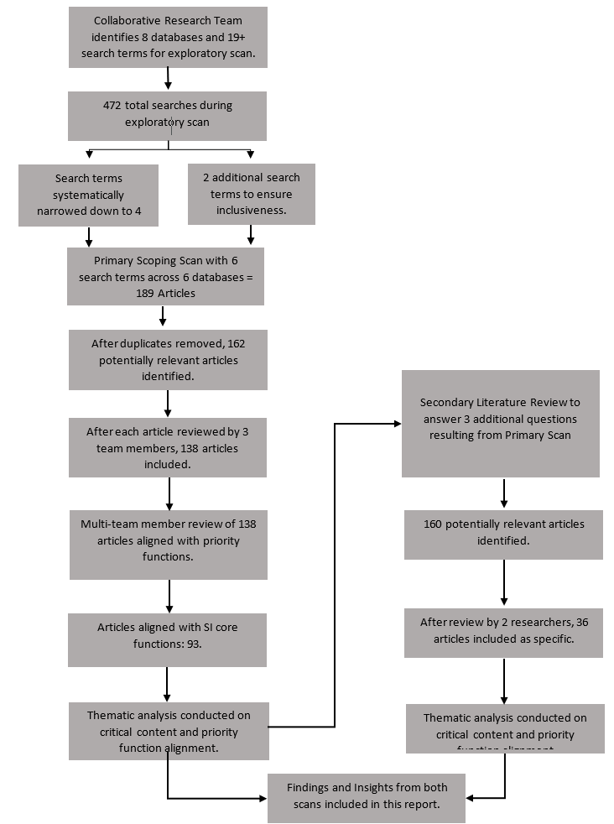
RURAL DEVELOPMENT INSTITUTE
Methods and Process
Process
Identifying research question and criteria
Identifying relevant articles
Iterative review of articles
Charting the data
Reporting and summarizing results
Collaboration and consultation
Nurturing Wellbeing in Rural Manitoba

Slide 15
RURAL DEVELOPMENT INSTITUTE
Research Limitations and Challenges
Limitations of a scoping review
Capacity challenges for community foundations
How to identify and nurture capacity
Nurturing Wellbeing in Rural Manitoba

Slide 16
Application example
STEP 1 Community philanthropy framework to understand wellbeing
STEP 2 Engage community to educate & understand wellbeing findings
STEP 3 Develop community narratives, based on findings, to inform next steps
STEP 4 Release narratives to community to support validation and solution development
STEP 5 Identify CF’s response to wellbeing priorities and communicate with community
Notes:
Example of pilot project with CF – this model was developed based on findings.
Model to community knowledge generation – adapting model to meet the [capacity] of the CF:
Two things to focus on in this slide:
Decide on framework – , reflect and understand principles of community philanthropy, leverage a wellbeing framework to ground process (ie CIW), expanding how we look at wellbeing in our communities
- what information do you have that you can use to inform a conversation with your community, aligned with the wellbeing, data relevant to your community, what is already being gathered [leadership]
Engagement - we know quantitative data doesn't highlight all voices, if we are hyper-local leadership, we need to hear and understand the data, put a voice, experience, context – qualitative/convening is critical [inclusivity]
ADD: wellbeing is at our core – our outcome

Slide 17
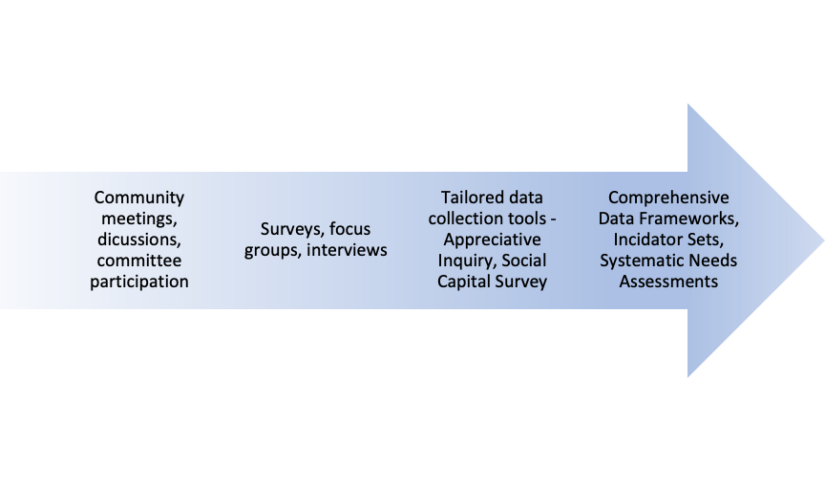
Implications
Wellbeing
Leadership
Diversity & Inclusion
Community convening activities
Generating community knowledge activities
Notes:
Confirmed that approach, that historic practices, that were traditionally more reactive, perhaps not as inclusion or connected to the community being served, with the lived experiences wasn’t enough. We now know better (through this process and its finding) we need to do better.
Simply put, we can’t grant our way out of social problems. Money along will not move the needle or enhance community wellbeing.
Can’t grant our way out of social problems.
People becoming more aware of their social priorities so they can work together.
So what? What are we at Endow Manitoba doing with these learnings?
Endow Manitoba, leveraging the SGI model, and the maturity matrix built into it, AND with a focus on these three overarching principles – we are meeting the CFs where they are, while balancing a provincial lens as well.
What does leadership look like for your CF?
Convening:
Supporting CFs in getting out there (best kept secret joke).
Supporting their charitable organizations by hosting workshops.
Generating community knowledge
Its not just about convening – hosting a town ha
Its about being intentional, grounding our work in wellbeing, reimaging and expanding the leadership role, and what this looks like, supported by intentional and inclusive actions.
This research was 3 years ago now, and the question we asked was how to increase engagement in Strategic Initiatives. We are now being ask – we want to, how do we do it?
Delete following notes:
Capacity requirements (social, financial & human) increase in tandem as the complexity of tools progresses
Community convening activities organized by capacity and complexity

Slide 18
RURAL DEVELOPMENT INSTITUTE
Methods and Process
Method
A scoping review was conducted to explore the existing literature base on community foundations and identify key articles relating to the core strategic initiative functions of community foundations: Community engagement and knowledge generation
Why a scoping review?
Identify the "scope" of existing knowledge
Identify gaps
Map key concepts
Nurturing Wellbeing in Rural Manitoba

