Slide 1
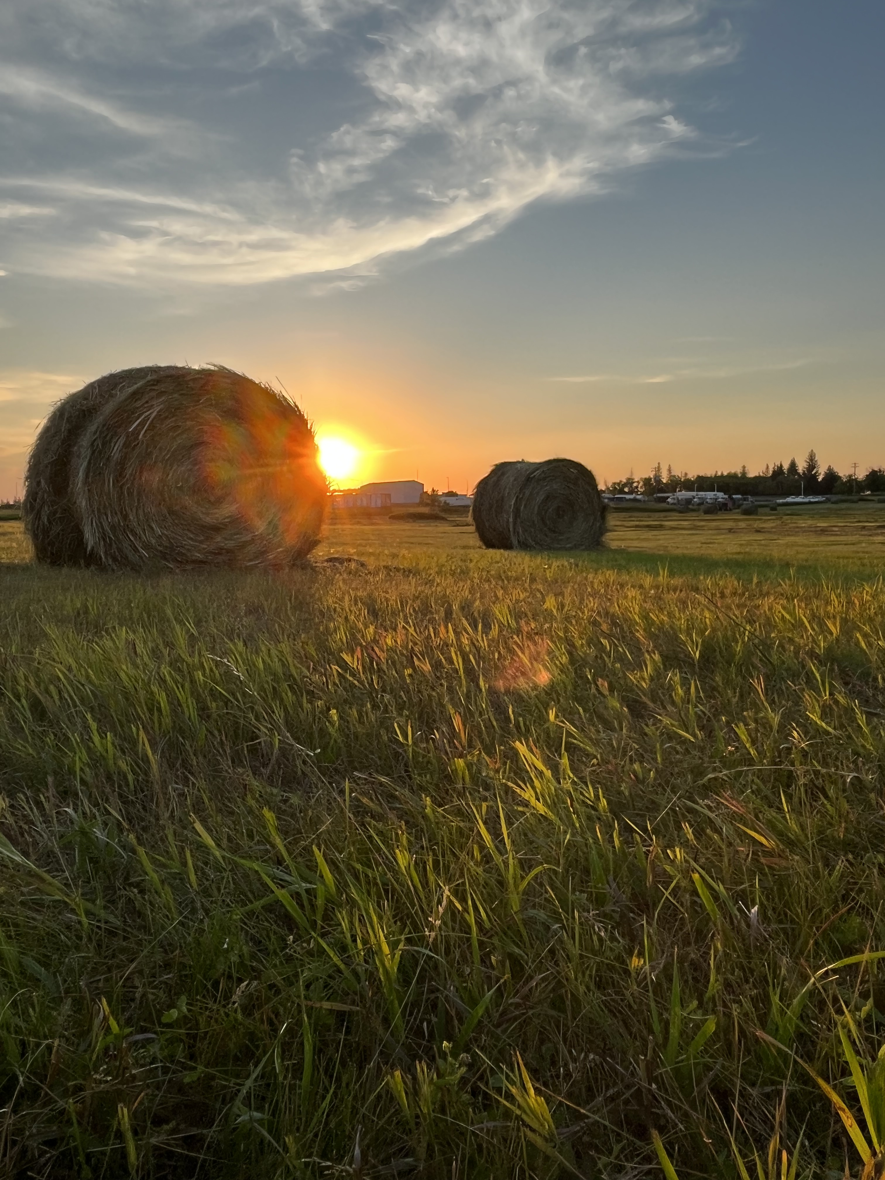






BRANDON UNIVERSITY
Photo courtesy of Sean Kelly
Leadership Brandon: Rural Development Institute
Dr. Wayne Kelly, Director
Rural Development Institute
February 23, 2024
Knowles Douglas Centre, Brandon University

Slide 2

RURAL DEVELOPMENT INSTITUTE
Outline
  What is RDI
  Where we come from
  Where we are now
  Where we are going
PRESENTATION NAME

Slide 3
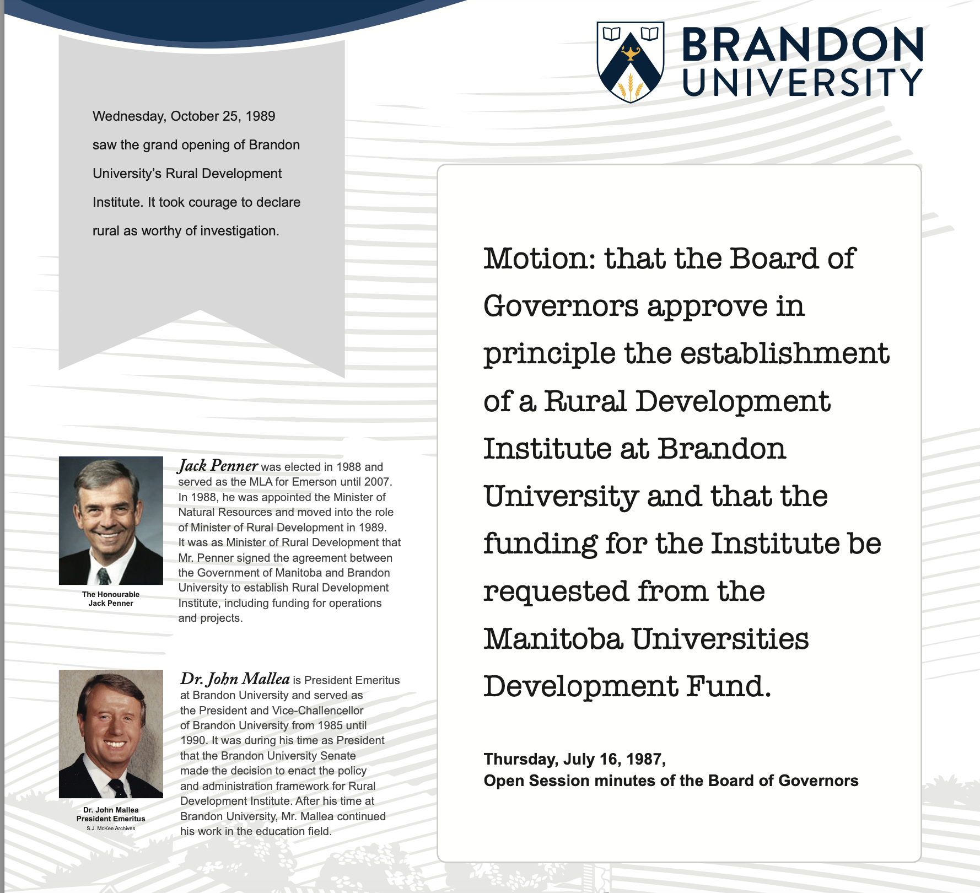
RURAL DEVELOPMENT INSTITUTE
WHERE WE COME FROM
35th year of operation, 5th Director
RDI is now part of the Faculty of Arts
Project based rural development research – a wide range of topics:
    economic development,
    immigration,
    digital rural,
    tourism,
    climate change,
    population health,
    rural policy,
    CED,
    well-being,
    entrepreneurship,
    rural data,
    rural capacity building,
    comparative research,
    international rural research
Leadership Brandon: Rural Development Institute
Notes:
Used to be a separate entity, RDI supported the creation of the Masters of Rural Development and is now part of the Faculty of Arts – Director is a member of the Department of Rural Development

Slide 4
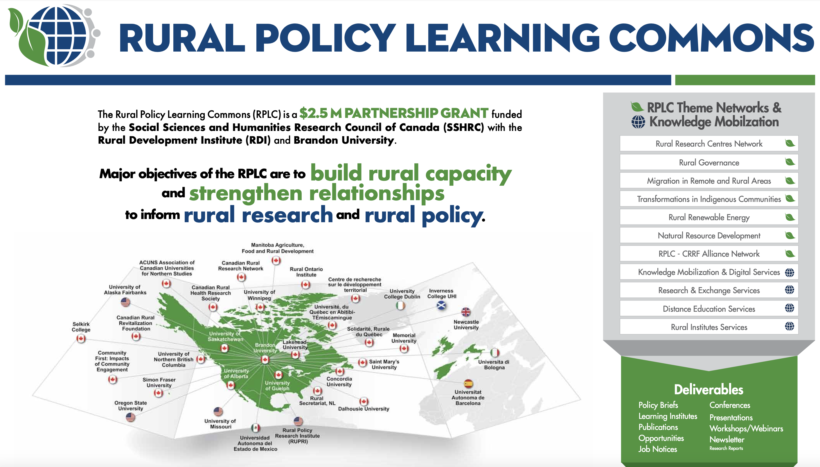
2014 - 2021

Slide 5
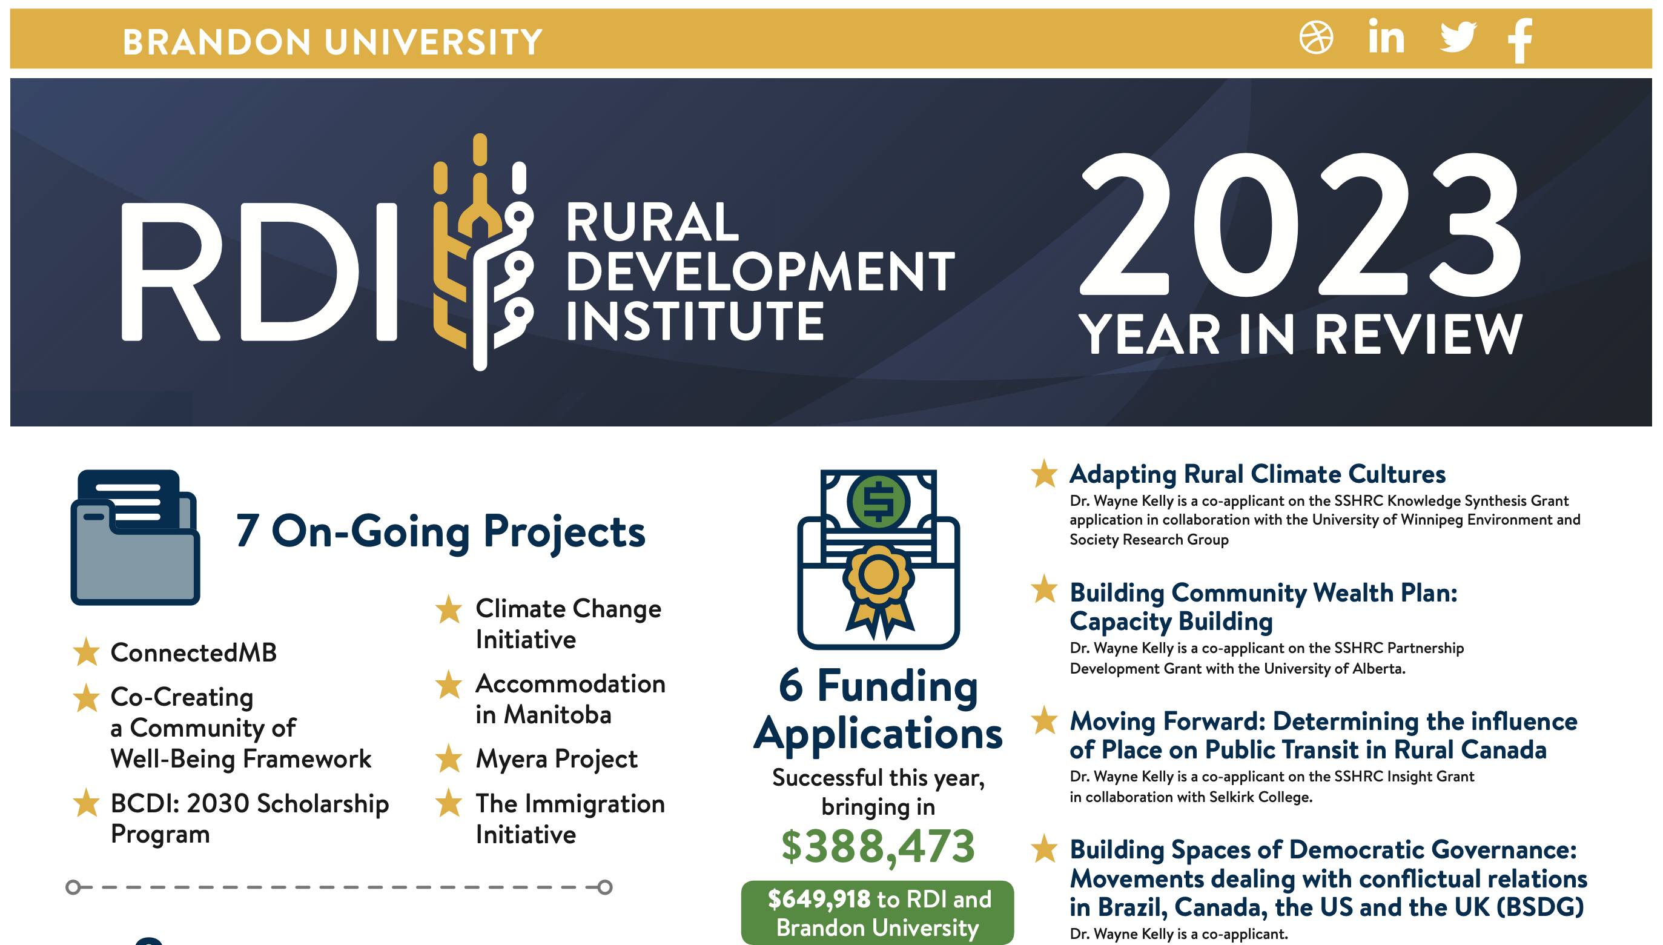

RURAL DEVELOPMENT INSTITUTE
WHERE WE ARE NOW

Slide 6
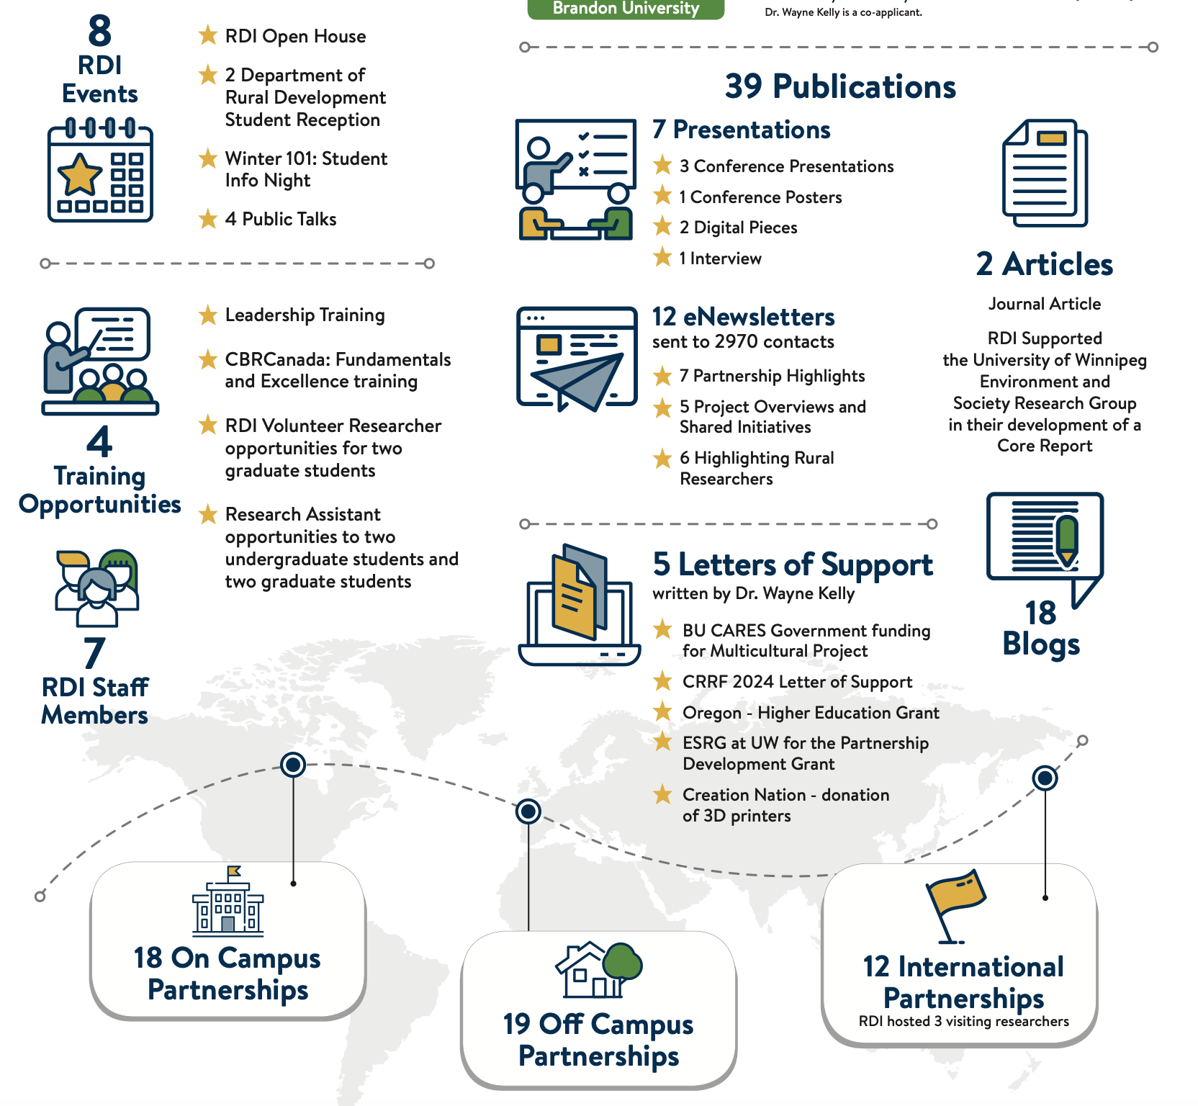
Where we are now

Slide 7
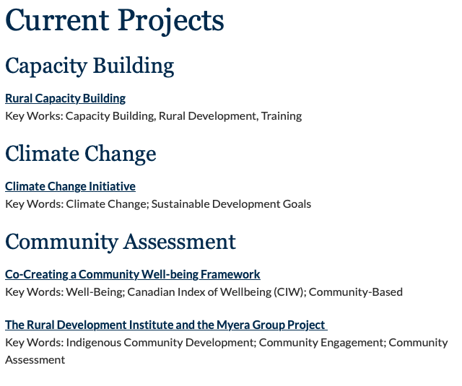
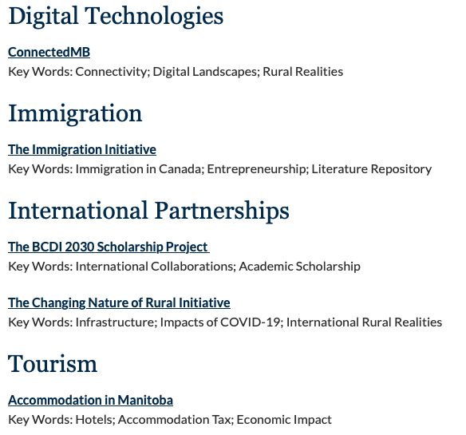
RURAL DEVELOPMENT INSTITUTE
WHERE WE ARE NOW
https://www.brandonu.ca/rdi/projects/

Slide 8
RURAL DEVELOPMENT INSTITUTE
WHERE ARE WE GOING
VISION: RDI’s research and collaboration support a vibrant southwestern region and rural Manitoba.

Slide 9
RURAL DEVELOPMENT INSTITUTE
WHERE ARE WE GOING
MOBILIZE RURAL KNOWLEDGE
BUILD RURAL RESEARCH THROUGH COLLABORATION
Sharing rural knowledge to academic and non-academic audiences at the regional, provincial, national and international levels Build on RDI's experience with KM in the RPLC project.
Collaborate internally at BU and externally to build the relationships needed for community-based research. Build on RDI's experience with Regional Round Tables to build rural research networks.
BUILD CAPACITY
of RDI, faculty, students, partners
&
communities
UNDERSTANDING THE FUTURE OF RURAL
MEASURING THE STATE OF RURAL
Identify changing realities of rural communities to guide community-driven research and actions. Identify priorities with community partners and BU colleagues to carry out strategic and specific rural research projects.
Determine the rural community strengths, assets and wellbeing. Work with partners, faculty and communities to design, adapt and implement assessment and well-being tools.

Slide 10
RURAL DEVELOPMENT INSTITUTE
WHERE ARE WE GOING
Rural Collaboration
Rural Research
Rural Assessments and Data
Rural Understanding & Concepts
Rural Knowledge Mobilization
Rural Capacity Building & Training

Slide 11
RURAL DEVELOPMENT INSTITUTE
WHERE ARE WE GOING
Rural Collaboration – build working research relationships with partners at all levels that are focused on rural community development/research
Rural Research – continue to engage in a variety of rural community-based research projects
Rural Assessments and Data – develop rural community measurement, assessment and data tools AND repositories
Rural Analysis and Understanding – continue to examine and identify common & critical rural development issues, challenges and opportunities
Rural Knowledge Mobilization – continue to share rural research findings, data and experiences at all levels
Rural Capacity Building – continue to determine and develop the capacity requirements AND gap training needed to support rural community development

Slide 12
RURAL DEVELOPMENT INSTITUTE
Any Questions or
Comments?
Thank You
Leadership Brandon: Rural Development Institute

